Slide 1


Hateful Meme Detection with Image-Text Based Multimodal Model
Presented by:
Srichandan Kota Rajasekhar Ponnuru Pavan Ganta

Slide 2
0 1
Introduction & Motivation
0 2
Problem statement/Hypothesis
0 3
Model/Methodology
CONTENT
0 4
Dataset
0 5
Exploratory data analysis
0 6
Implementation
07
Results
0 8
Project Management

Slide 3

01
Introduction & Motivation

Slide 4
Introduction & Motivation
The motivation behind this endeavor is rooted in the dual nature of memes on social networks. While memes serve as a popular and engaging means of communication, some can harbor offensive elements that may lead to harm, both emotionally and psychologically. As memes increasingly become a tool for expression and humor, it is essential to address the darker side of their impact. This project seeks to strike a balance by fostering the positive aspects of meme culture while mitigating the spread of offensive content.
Memes have proliferated as a communication tool on social media, encouraging comedy and a sense of community on sites like Facebook and Instagram. But the unbridled spread of memes has also led to a worrying development: inflammatory content that may be harmful to certain people or groups. This project seeks to use artificial intelligence, primarily computer vision and text extraction techniques, in response to the growing concern over objectionable memes that are making the rounds on social networks.
Introduction
Motivation
Method
Extract important features from both text and image
Concat the multimodal features
Classify the meme with multimodal features input

Slide 5
Introduction & Motivation
Hateful
Meme
Detection
Definition of the hateful meme
A meme contains direct or indirect attack on people based on characteristics, including ethnicity, race, nationality, immigration status, religion, caste, sex, gender identity, sexual orientation, and disability or disease. We define attack as violent or dehumanizing(comparing people to non-human things, e.g. animals) speech, statements of inferiority, and calls for exclusion or segregation.A meme includes mocking hate crime is also considered hateful meme.

Slide 6
02
Problem statement/Hypothesis

Slide 7
Problem statement/Hypothesis
Hateful
Meme
Detection
Problem statement/Hypothesis
Memes are a popular way for people to express themselves online, but this has led to a worrying problem: a lot of harmful stuff that can hurt people or certain groups. Memes remain a popular form of communication on social media platforms like Facebook and Instagram, therefore addressing the problem of detecting and removing inappropriate memes is critical. The well-being of users and the standard of online discourse are at risk due to the absence of an effective and automated method for identifying and managing such content.
We hypothesise that we can create a strong model that can reliably identify offensive memes in photos published on social media platforms by utilizing artificial intelligence techniques, more especially by combining computer vision and text extraction methodologies. According to the premise, a machine learning-enabled well-trained algorithm should be able to identify the language nuances, context, and patterns that signal the presence of objectionable content in memes. By using this method, we hope to develop a proactive solution that not only recognizes inappropriate memes but also lessens harassment and safeguards people's mental health, making the internet a safer and more welcoming place.

Slide 8
03
Model/Methodology

Slide 9

Memes
Overall workflow diagram
Method
Procedures
Text Feature
Extraction
Image Feature Extraction
Step1
Extract image and text features
Step2
Run unimodal classification on image and text features
Tag Extraction
Step3
Extract tag with useful hate-related information
Unimodal
Unimodal
Feature
Concatenation
Step4
Concat three channel's input: text, tag, image
Multimodal
Step5
Run multimodal classification on concatenated features.
Classification Model
Output

Slide 10

Architecture diagram of our main model - Visual BERT
Visual Bert-Based Classifier
Dataset
Preprocessing
Image Regions, and face recognition using Cascade classifier
Text Description :Using OCR with image dataset
Race/Gender/Emotion/Objection Tags
Using RCNN, and YOLO for Object Tags
Token Embedding
[CLS]
where
my
water
[SEP]
White
Male
Sad
Person
[SEP]
[IMG]
[IMG]
Visual Feature
Embedding
Token
Type
Embedding
A
A
A
A
A
B
B
B
B
B
C
C
Visual Bert Classifier (Multi Modal Classifier)
Non-Hateful
Hateful

Slide 11

04
Dataset Link : https://www.kaggle.com/datasets/parthplc/facebook-hateful-meme-dataset

Slide 12
Dataset Components
The Facebook Hateful Meme Dataset is designed for the purpose of developing algorithms that can identify multimodal hate speech in internet memes. The dataset is substantial, comprising various components and files. Let's break down the key elements:
1) img/ Directory: This directory contains 10,000 PNG image files. These images serve as the visual component of the memes and are crucial for developing a multimodal hate speech detection algorithm.
2) LICENSE.txt: This file outlines the dataset's license, providing information about the terms and conditions for usage.
README.md: The README file offers essential information about the dataset, guiding users on its structure, purpose, and usage.
3) dev.jsonl: This JSON file contains the development set, representing a portion of the dataset used for fine-tuning and validation during the algorithm development phase.
4) test.jsonl: The test set is contained in this JSON file, representing a set of data that the algorithm has not been exposed to during training. It is used for evaluating the model's performance.
5) train.jsonl: This JSON file includes the training set, which is utilized to train the algorithm to recognize patterns and features associated with hate speech in memes.
6) submission_format.csv: This CSV file provides a template for the submission format required for the competition's leaderboard.
Dataset Description
The dataset's primary goal is to address the challenge of identifying multimodal hate speech in internet memes. Memes, formed by combining images and text, can be harmless or take on a hateful nature depending on the content. The dataset reflects the complexity of this task and emphasizes the importance of multimodal analysis.
Hate speech, as defined by the dataset, includes direct or indirect attacks on individuals based on various characteristics such as ethnicity, race, nationality, religion, gender identity, sexual orientation, and more. The dataset follows Facebook's hate speech policy for classification, which involves identifying violent or dehumanizing speech, statements of inferiority, and calls for exclusion or segregation.

Slide 13
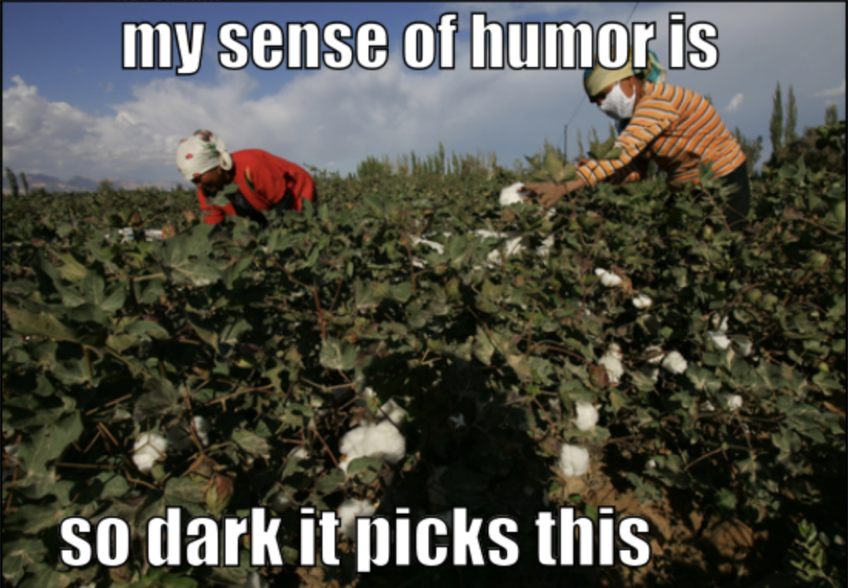
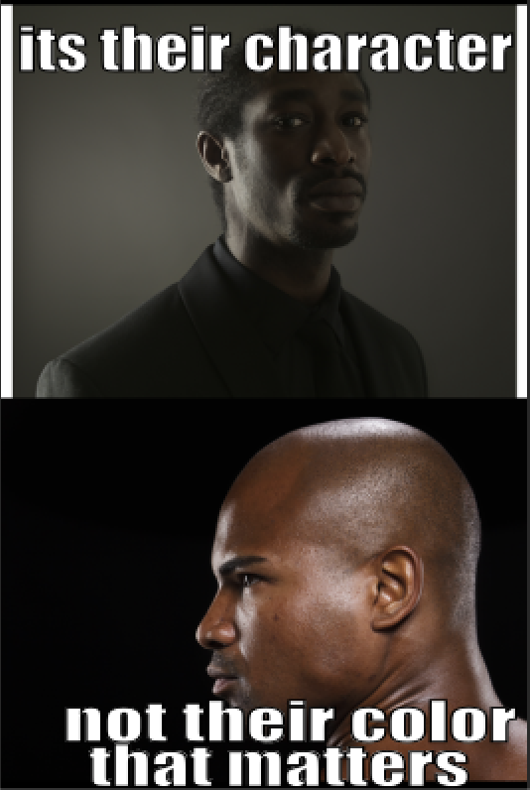
Design of Features/Labels with Diagram
Due to the textual and visual nature of memes, the features are expected to include both image data and text data. The design of features can be represented as follows:
1) Image Features:
Extracted from the 'img/' directory.
Image data represented in a structured format compatible with the chosen machine learning model (e.g., image embeddings).
2) Text Features:
Extracted from the textual content associated with each meme in the JSON files (train.jsonl, dev.jsonl, test.jsonl).
Text data preprocessed and converted into a suitable format for analysis (e.g., tokenization, embeddings).
3) Labels:
Binary labels indicating whether the meme is classified as hateful or non-hateful, following the defined criteria for hate speech.
The jsonl contains its structure as, where the label part won’t be present in test data :
"root":{4 items
"id":int42953
"img":string"img/42953.png"
"label":int0
"text":string"its their character not their color that matters"
}

Slide 14
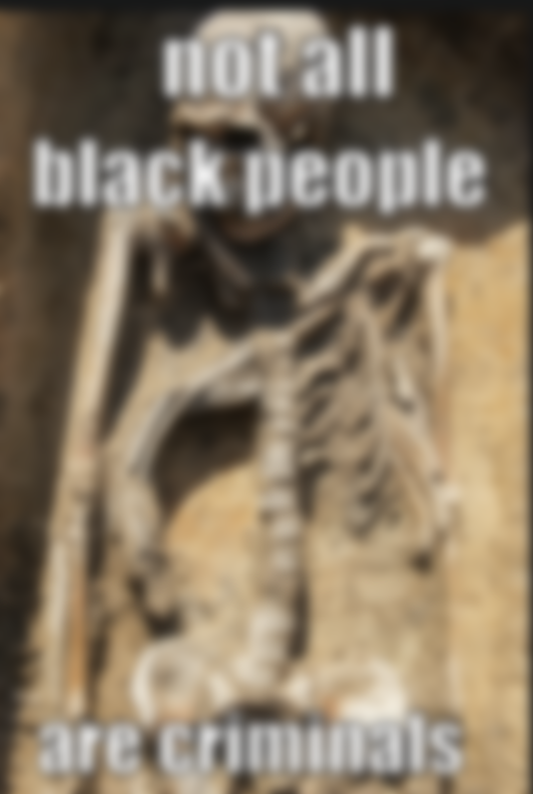
Design of Features/Labels with Diagram
label : 0
The diagram shows how image features are related to the label, similarly the text which is extracted from these image will go throught several steps to detect weather it is considered label 1 or 0, where 1 means hateful or offensive and 0 means non-offensive.
label : 1
Intentionally made blurry

Slide 15
05
Exploratory data analysis

Slide 16
Train Data:
<class 'pandas.core.frame.DataFrame'>
RangeIndex: 8500 entries, 0 to 8499
Data columns (total 4 columns):
# Column Non-Null Count Dtype
--- ------ -------------- -----
0 id 8500 non-null int64
1 img 8500 non-null object
2 label 8500 non-null int64
3 text 8500 non-null object
dtypes: int64(2), object(2)
memory usage: 265.8+ KB
None
Dev Data:
<class 'pandas.core.frame.DataFrame'>
Int64Index: 1040 entries, 0 to 539
Data columns (total 4 columns):
# Column Non-Null Count Dtype
--- ------ -------------- -----
0 id 1040 non-null int64
1 img 1040 non-null object
2 label 1040 non-null int64
3 text 1040 non-null object
dtypes: int64(2), object(2)
memory usage: 40.6+ KB
None
Test Data:
<class 'pandas.core.frame.DataFrame'>
Int64Index: 3000 entries, 0 to 1999
Data columns (total 4 columns):
# Column Non-Null Count Dtype
--- ------ -------------- -----
0 id 3000 non-null int64
1 img 3000 non-null object
2 label 3000 non-null int64
3 text 3000 non-null object
dtypes: int64(2), object(2)
memory usage: 117.2+ KB
None
Exploratory data analysis : Data Visualization
Our exploratory data analysis includes :
1) loading the dataset into dev_data, train_data and test_data.
2) Getting the info of these dev_data, train_data and test_data.
3) Getting Description of these variables.
4) Distribution analysis of labels in train data with repect to target variable “label”.
5) Finding categorical variables
6) Plotting a scatter plot of text length vs target variable “label”.
7) Target Variable Analysis
8) Text Analysis by Analyze word frequency in the training data
9) Sentiment Analysis
10) Text Length Analysis
11) Outlier detection for train.jsonl
12 Train data label distribution using pie chart
13) Test data label distribution using pie chart
Note : The results of these are displayed in next slide with appropriate plot label
matching the description of EDA.
2

Slide 17
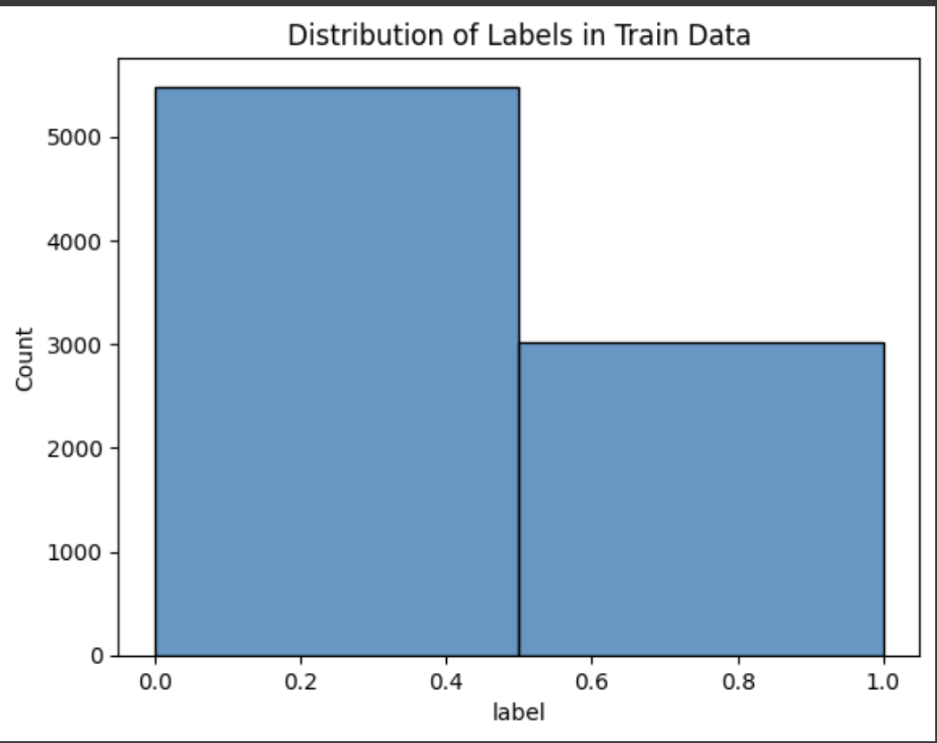
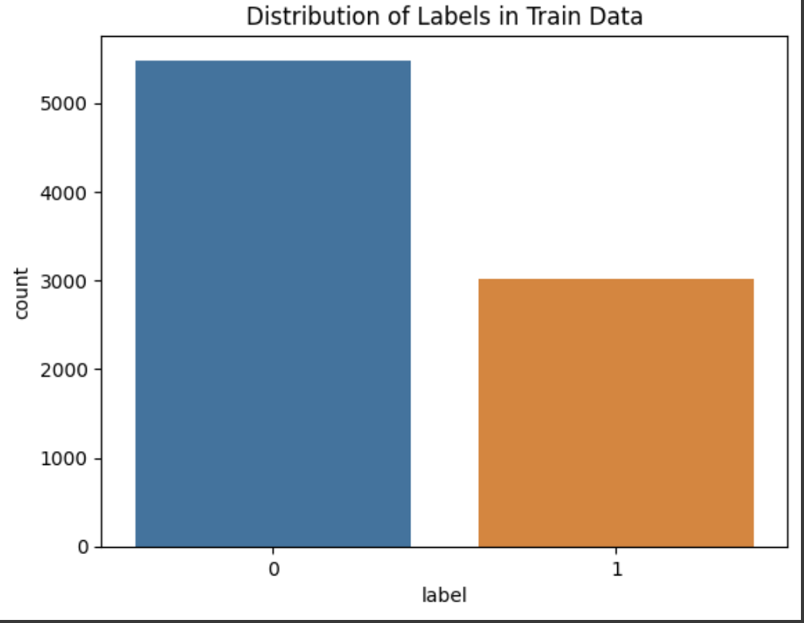
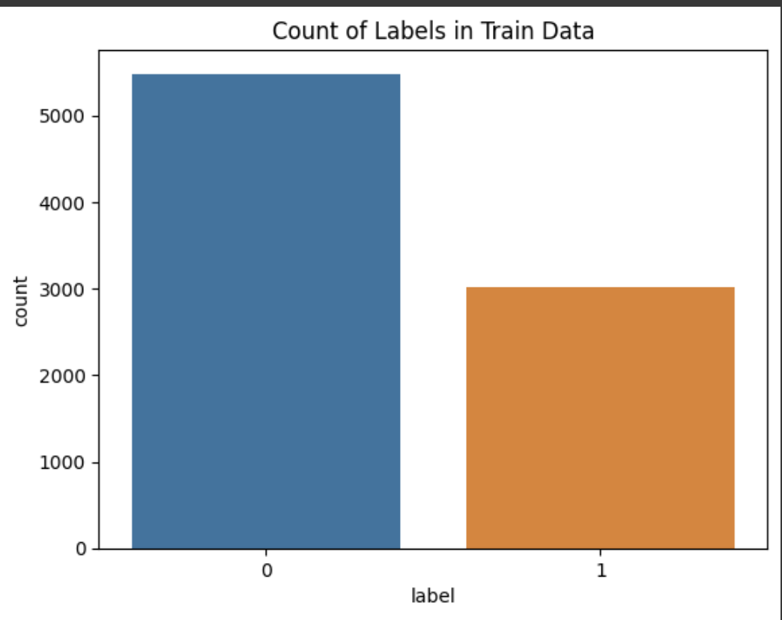
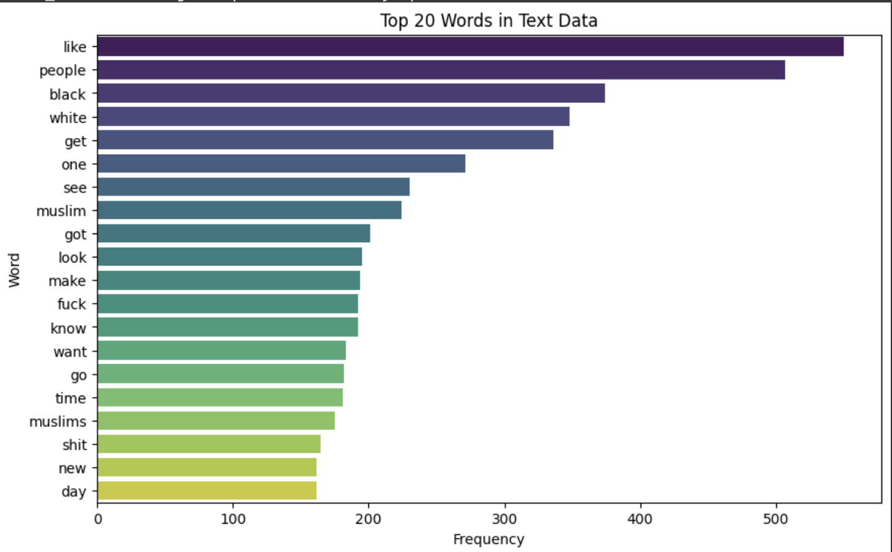
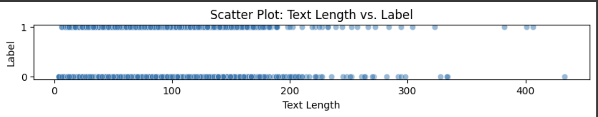
Exploratory data analysis : Data Visualization
2

Slide 18
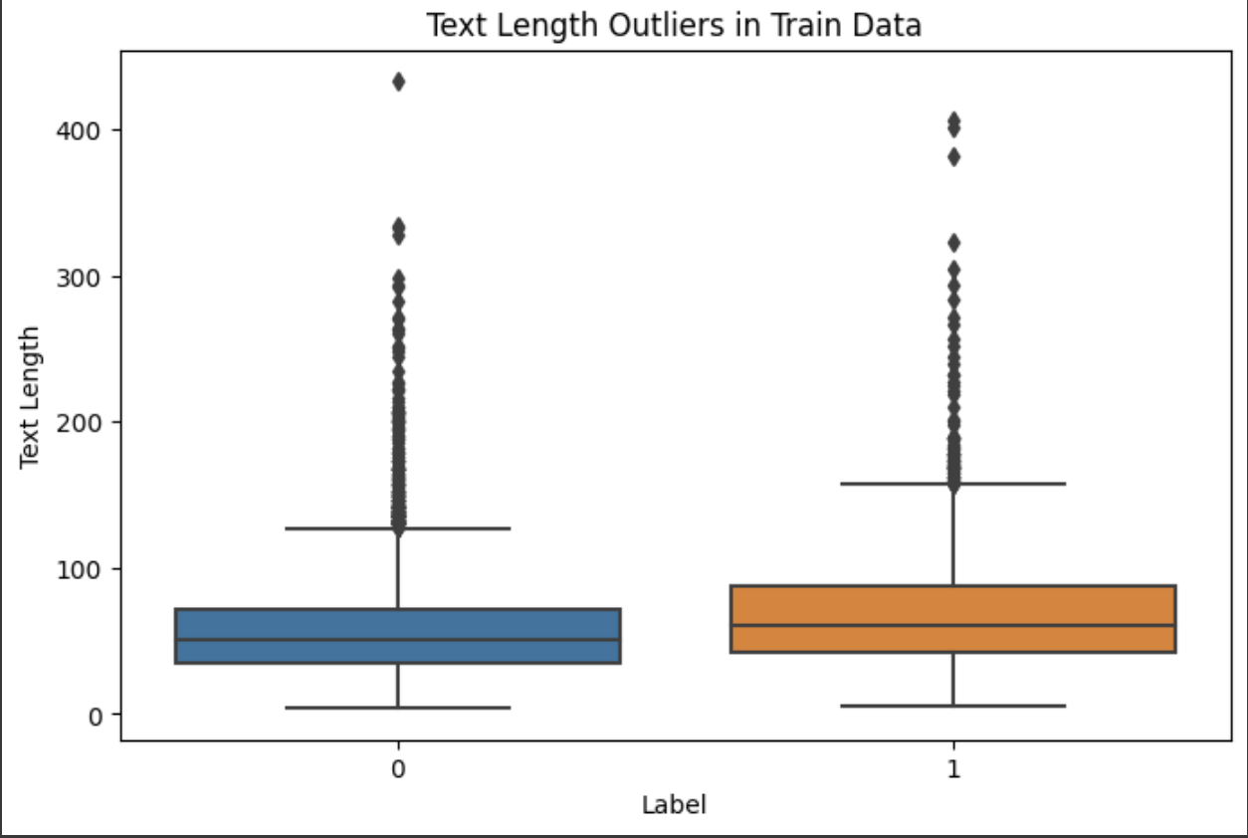
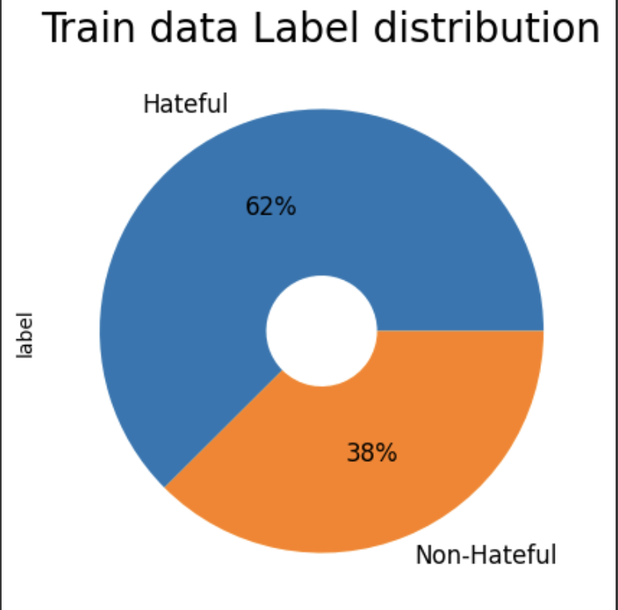
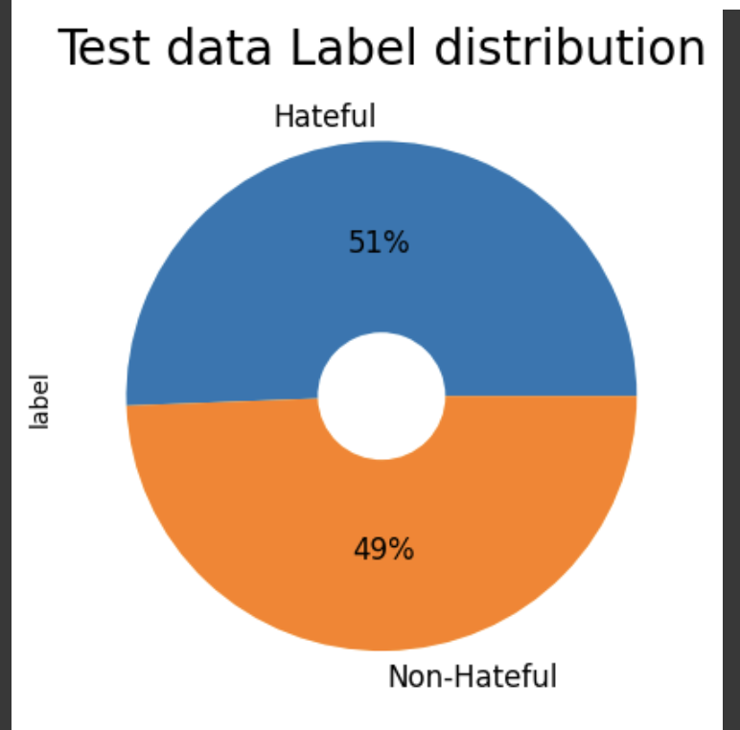
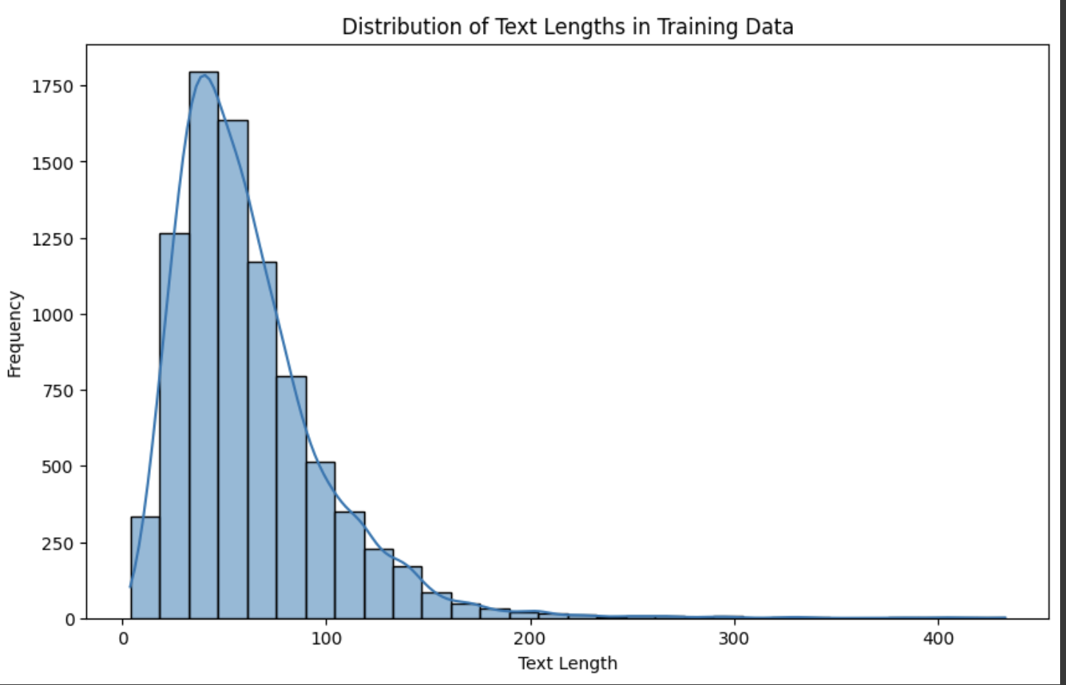
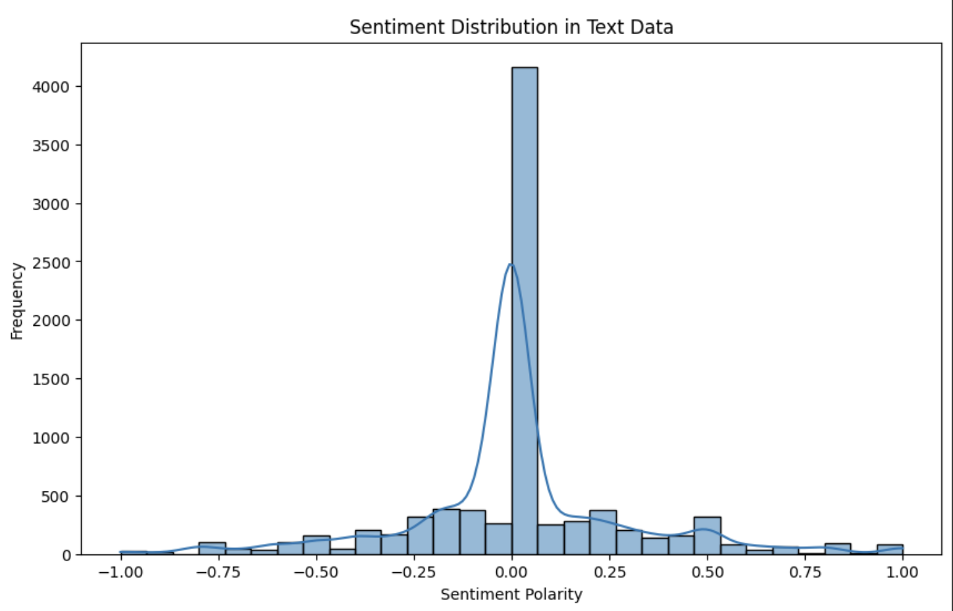
Exploratory data analysis : Data Visualization
2

Slide 19
Exploratory data analysis : Preprocessing
1) Checked for missing values in the dataset, using : isnull().sum(), where all the values are of 0 value, which indicates that there are no missing values in our dataaset. 2) We have split our test.jsonl to test_seen.jsonl and test_unseen.jsonl, and dev.jsonl to dev_seen.jsonl and dev_unseen.jsonl, for better training and testing of our models, which will be covered in future slides. 3) We have used different Natural Language Processing techniques for deadling the pre-processing of data. Our data text has been generated by OCR which is Optical Character Recognition technique, where the output might not be a clean text, so processing it would be necessary for better result.
def clean_text(text):
# Convert to lowercase
text = text.lower()
# Remove HTML tags and URLs
soup = BeautifulSoup(text, 'html.parser')
text = soup.get_text()
text = re.sub(r'http\S+|www\S+|https\S+', '', text, flags=re.MULTILINE)
# Remove non-alphabetic characters
text = re.sub(r'[^a-zA-Z\s]', '', text)
# Tokenization
tokens = word_tokenize(text)
# Remove stopwords
stop_words = set(stopwords.words('english'))
tokens = [word for word in tokens if word not in stop_words]
# Lemmatization
lemmatizer = WordNetLemmatizer()
tokens = [lemmatizer.lemmatize(word) for word in tokens]
# Join tokens back into text
cleaned_text = ' '.join(tokens)
return cleaned_text
We have used this function to clear our data in the dataset
this function includes : LowerCase character conversion,
HTML tags and URLs removal, non-alphabetic characters
removal, Tokenization, Stop words removal, Lemmatization,
and then after performing all these steps we combine the
tokens and replace the text fields with these respective
clean texts.

Slide 20

06
Implementation

Slide 21
Implementation
For implementation we have done :
I) Unimodal Models 1) TextCNN 2) Face Recognition
3) Entity or Object Recognition
4) BERT
5) OCR
6) TF_IDF
7) RESNET
II) Multimodal Models
8) VisualBERT

Slide 22
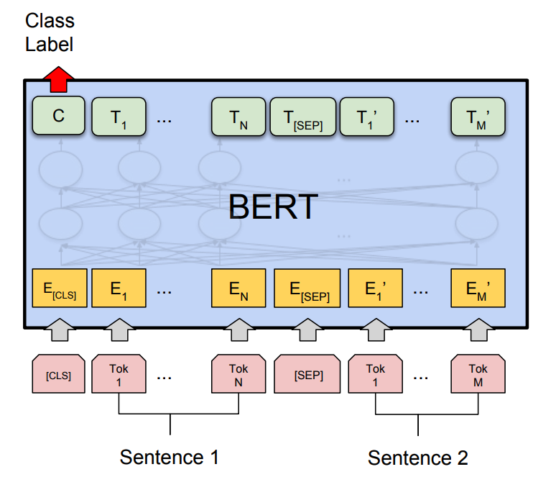
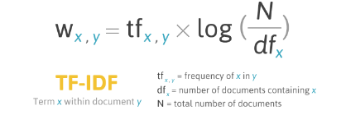
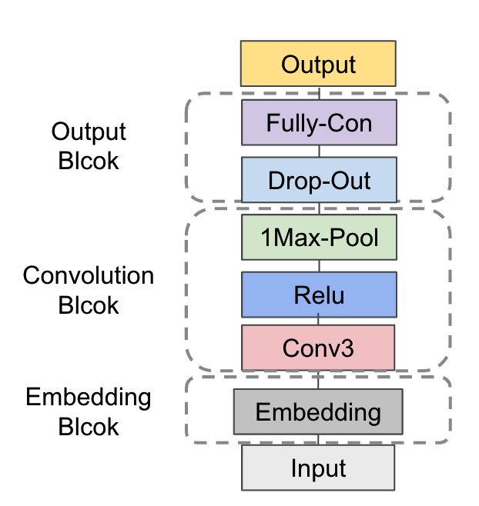
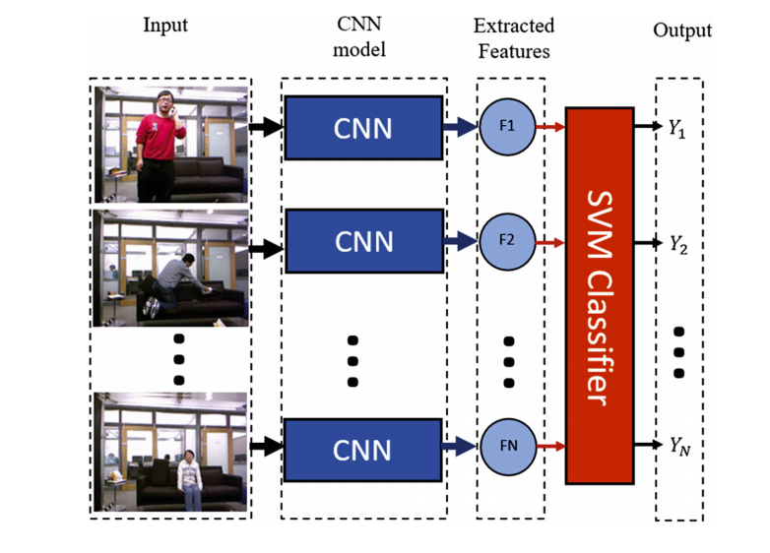
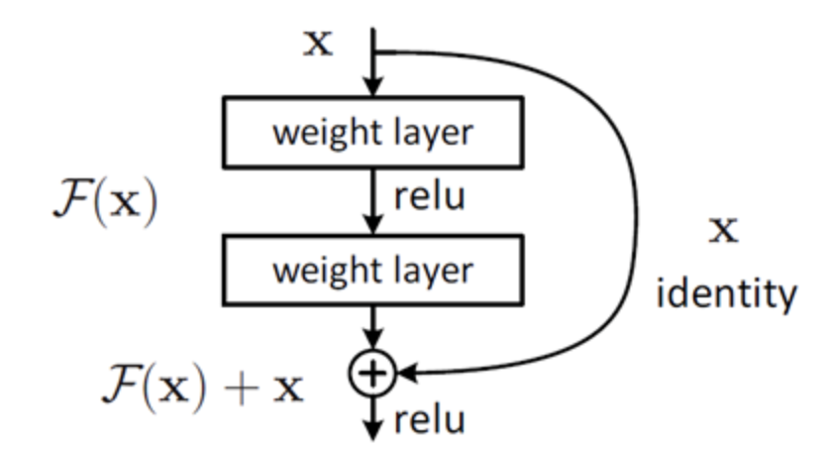
I) Unimodal Models
BERT Based Model^{[8]} (Text)
Tokenize and encode the whole sentence.
ResNet50 Based Model^{[9]} (Image)
Extract image features with deep CNN.
TF-IDF Based Models^{[6]} (Text)
Extract features measuring importance of each word.
Then apply some naive Machine Learning algorithms.
Text-CNN Based Model^{[7]} (Text)
Capture local features. (Better for short texts)

Slide 23
Implementation : Text CNN
The model chosen for this task is TextCNN (Convolutional Neural Network for Text). TextCNN is a type of neural network architecture specifically designed for processing text data. It is effective in capturing local patterns and features in sequential data, making it suitable for tasks like sentiment analysis, spam detection, and, in this case, hateful meme detection.
Steps of pseudo code used for implementing this Text CNN are : 1) Data Loading and Preprocessing:
# Load Data
path = '/Users/ikea/Documents/DKU/STATS402/hateful_memes/'
train_data = read_json(path+'train.jsonl', lines=True)
# ... Similar loading for other datasets
# Concatenate Data
train_data = concatenate(train_data, test_data)
train_data = concatenate(train_data, dev_unseen_data)
train_data = concatenate(train_data, final_test_data)
train_data = concatenate(train_data, test_unseen_data)
# Visualize Label Distribution
plot_pie_chart(train_data.label, title='Train data Label distribution')
# Create Vocabulary
vocab = create_vocab(train_data.text)
write_to_file("vocab.txt", vocab)
char2idx, idx2char = create_mappings(vocab)
2. Text Tokenization and Vocabulary Creation:
# Tokenization and Mapping
sequence_length = 385
data_input = tokenize_text(train_data.text, char2idx, sequence_length)
# Example Tokenizer Function
function tokenize_text(text, char2idx, sequence_length):
tokenized_data = []
for sentence in text:
tokenized_sentence = [char2idx.get(char, unk_id) for char in sentence]
tokenized_data.append(pad_or_trim(tokenized_sentence, sequence_length))
return tokenized_data
3. TextCNN Model Implementation
# Define Model
model = TextCNN(embedding_size=100, filter_num=10, sequence_length=385, vocab_size=len(vocab), num_classes=2)
# Example TextCNN Model Class
class TextCNN:
function __init__(self, embedding_size, filter_num, sequence_length, vocab_size, num_classes):
# ... Initialize model components
function forward(self, X):
# ... Forward pass logic

Slide 24
Implementation : Text CNN
Libraries used : Pandas:
Used for data manipulation and analysis.
Reading JSON files (pd.read_json).
Concatenating dataframes (pd.concat).
Creating and manipulating data structures.
Matplotlib and Seaborn:
Used for data visualization.
Plotting pie charts (plt.pie).
Visualizing confusion matrix using a heatmap (sns.heatmap).
Plotting accuracy over epochs (plt.plot).
Numpy:
Used for numerical operations and array manipulation.
Handling numerical data, calculating accuracy, and creating arrays.
OS and Shutil:
Operating System and Shell Utilities.
Handling file paths and directory operations.
Collections:
Used for specialized container datatypes.
Counting occurrences of characters (Counter).
PyTorch:
Used for building and training neural networks.
Defining and training a TextCNN model (torch.nn, torch.optim).
Creating datasets and dataloaders (torch.utils.data).
Utilizing GPU (if available) for computation (torch.device).
TQDM:
Used for adding progress bars during loops.
Visualizing progress during training (tqdm.tqdm).
Scikit-learn:
Used for machine learning operations and metrics.
Calculating ROC AUC score (roc_auc_score).
Generating ROC curves (roc_curve).
Calculating confusion matrix and classification report (confusion_matrix, classification_report).
4. Training and Evaluation:
# Training
for epoch in range(1, Epoch+1):
train_accuracy, y_train, pred_train = train()
# Evaluation
test_accuracy, y_test, pred_test = evaluate()
5. Model Evaluation Metrics:
# Metrics
auc_score = calculate_auc_score(y_test, pred_test)
confusion_matrix = calculate_confusion_matrix(y_test, pred_test)
classification_report = generate_classification_report(y_test, pred_test
6. ROC Curve Visualization:
# ROC Curve
test_fpr, test_tpr = calculate_roc_curve(y_test, pred_test)
plot_roc_curve(test_fpr, test_tpr, auc_score, label='Test')
# Training Loop Visualization
plot_accuracy_over_epochs(train_accuracy, test_accuracy)
7. Training Loop:
# Training Loop
function train():
for batch_x, batch_y in train_dataloader:
# ... Training logic
loss.backward()
optimizer.step()
function evaluate():
for x_batch, y_batch in test_dataloader:
# ... Evaluation logic

Slide 25
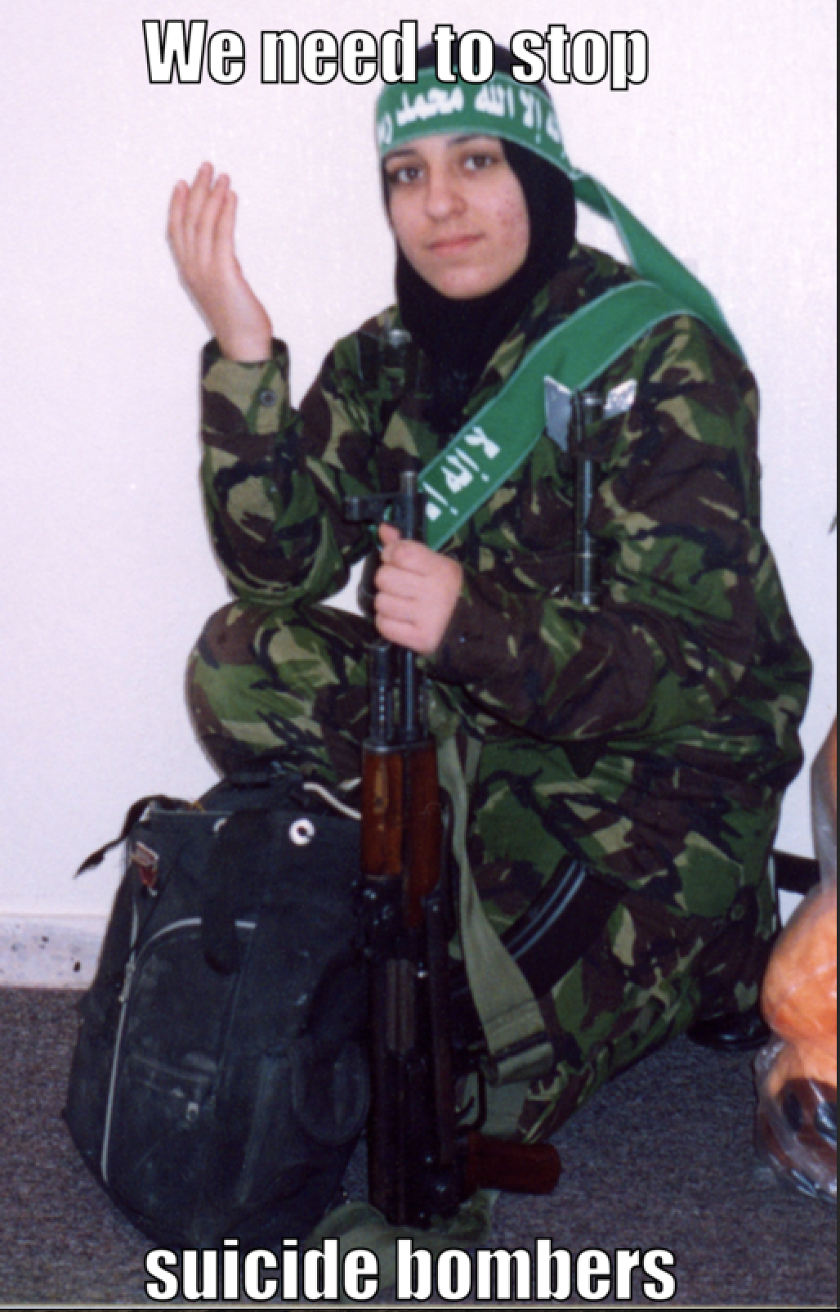
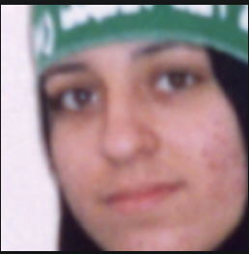
Implementation : Face Extraction
# Loop through each image in the 'img' column of data1
for each in data['img']:
print(each)
img_path = path + each
# Read the image using OpenCV
img = cv2.imread(img_path)
# Create a face detection engine using the Haar Cascade Classifier
face_engine = cv2.CascadeClassifier(cv2.data.haarcascades + 'haarcascade_frontalface_default.xml')
# Detect faces in the image
faces = face_engine.detectMultiScale(img, scaleFactor=1.3, minNeighbors=5)
# Check if any faces are detected
if faces != ():
max_area = 0
max_coordinate = None
# Iterate through detected faces to find the one with the maximum area
for (x, y, w, h) in faces:
area = h * w
print(area)
if area > max_area:
max_area = area
max_coordinate = (x, y, w, h)
# Crop the image to the region of interest (ROI) containing the face
cropped = img[max_coordinate[1]:max_coordinate[1] + max_coordinate[3], max_coordinate[0]:max_coordinate[0] + max_coordinate[2]]
# Resize the cropped image to 128x128 pixels
resized_image = cv2.resize(cropped, (128, 128), interpolation=cv2.INTER_AREA)
# Save the resized image to the specified directory with a modified filename
cv2.imwrite(path2 + each[4:], resized_image)
Output image

Slide 26

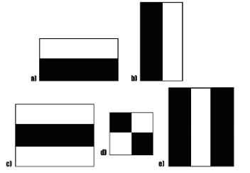
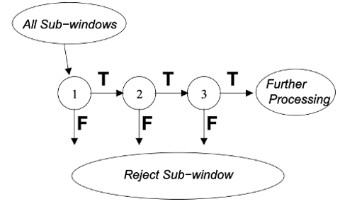
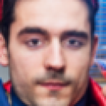
Face Extraction – Haar Cascade Classifier^{[11]}
Haar-like Features:
Compare RGB values with adjacent rectangular areas to extract feature.
Cascaded Classifier:
Input all potential sub-windows into the classifier and reject sub-windows stage by stage.

Slide 27
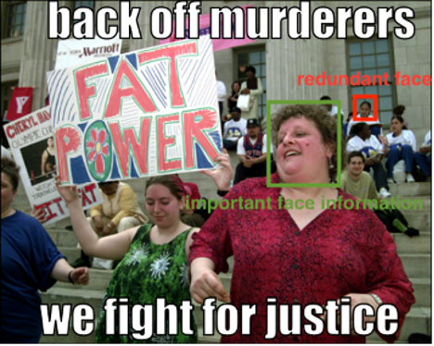
Face Extraction - Multiple Face Problem
Usually redundant and unrelated faces in each image
Solution:
Include only largest face in each image

Slide 28
Implementation : Object or Entity Recognition
data = pd.concat([train_data, test_seen_data, test_unseen_data, dev_seen_data, dev_unseen_data])
data1 = data.drop_duplicates(subset=['img'])
# Initialize dictionary to store detected objects for each image
objects = {}
# Loop through each image in the 'img' column of data1
for each in data1['img']:
print(each)
img_path = path2 + each
# Load YOLOv5 model
model = torch.hub.load('ultralytics/yolov5', 'yolov5s')
# Run YOLOv5 on the image
results = model(img_path)
# Extract unique detected object names
detected_objects = results.pandas().xyxy[0]['name'].unique()
print(detected_objects)
# Store the detected objects in the dictionary
objects[each] = detected_objects
# Display the dictionary of detected objects for each image
objects
In the provided code snippet, the YOLOv5 object detection model is utilized to detect objects in a collection of images related to a dataset on hateful memes. The script first loads the required libraries, mounts Google Drive to access the dataset, and reads the dataset into a Pandas DataFrame. Subsequently, it iterates through each unique image in the dataset, loads the YOLOv5 model, and applies it to the image using the torch.hub.load function. The model then predicts objects in the image, and the unique names of these objects are extracted using the results.pandas().xyxy[0]['name'].unique() method. The detected objects for each image are stored in a dictionary for further analysis or use. This process allows for automated and efficient object detection in images, providing insights into the visual content of the meme dataset.
Libraries : torch for PyTorch, the deep learning library.
yolov5 for the YOLOv5 object detection model.
utils from yolov5 for utility functions.
google.colab for mounting Google Drive.
pandas for data manipulation and analysis.

Slide 29
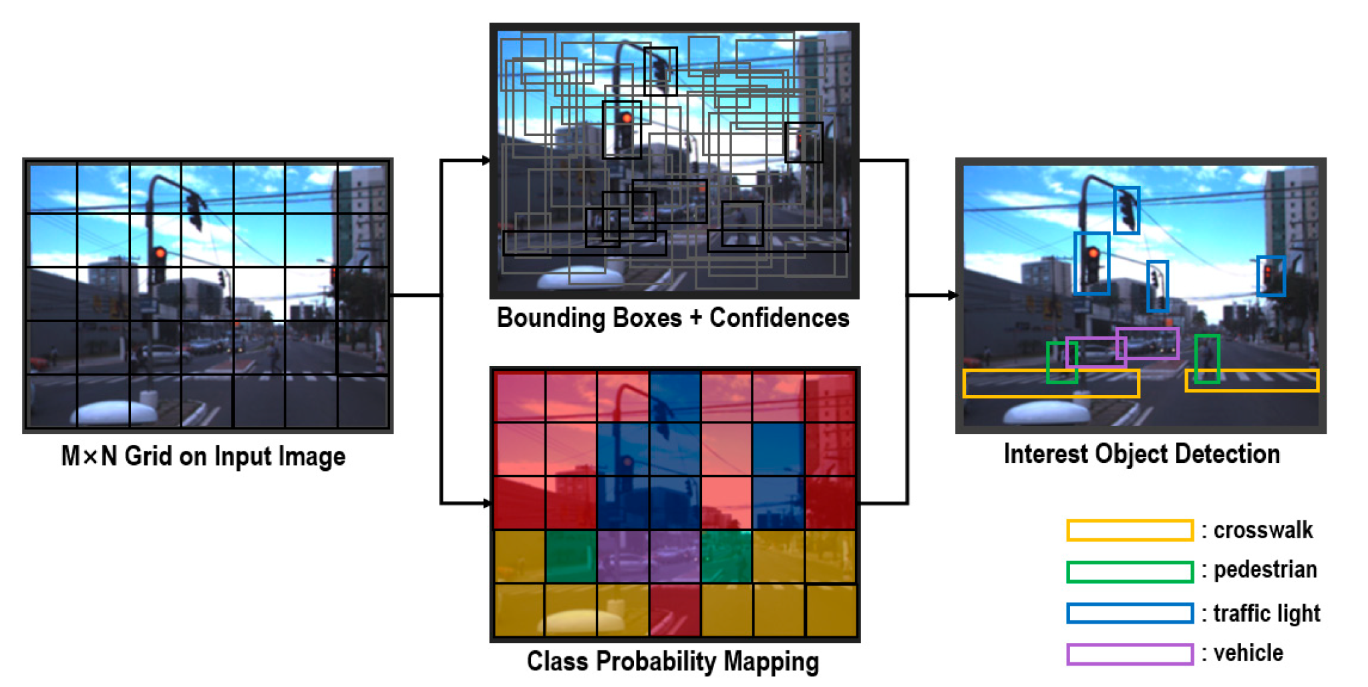
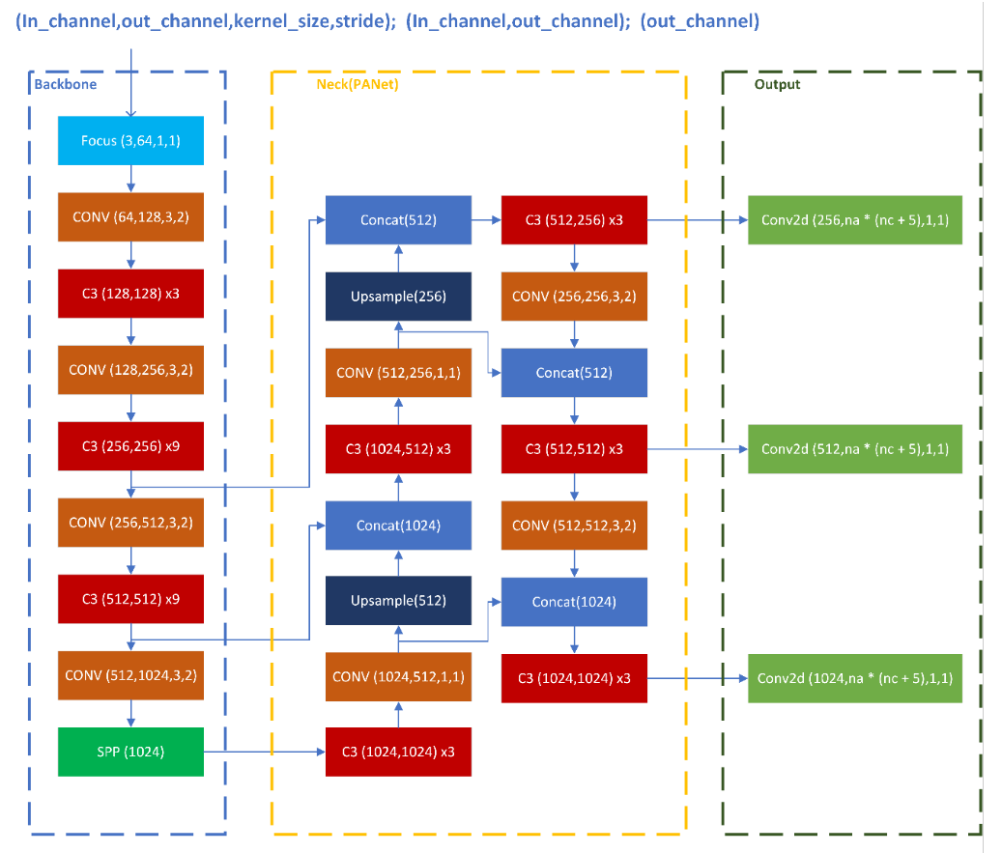
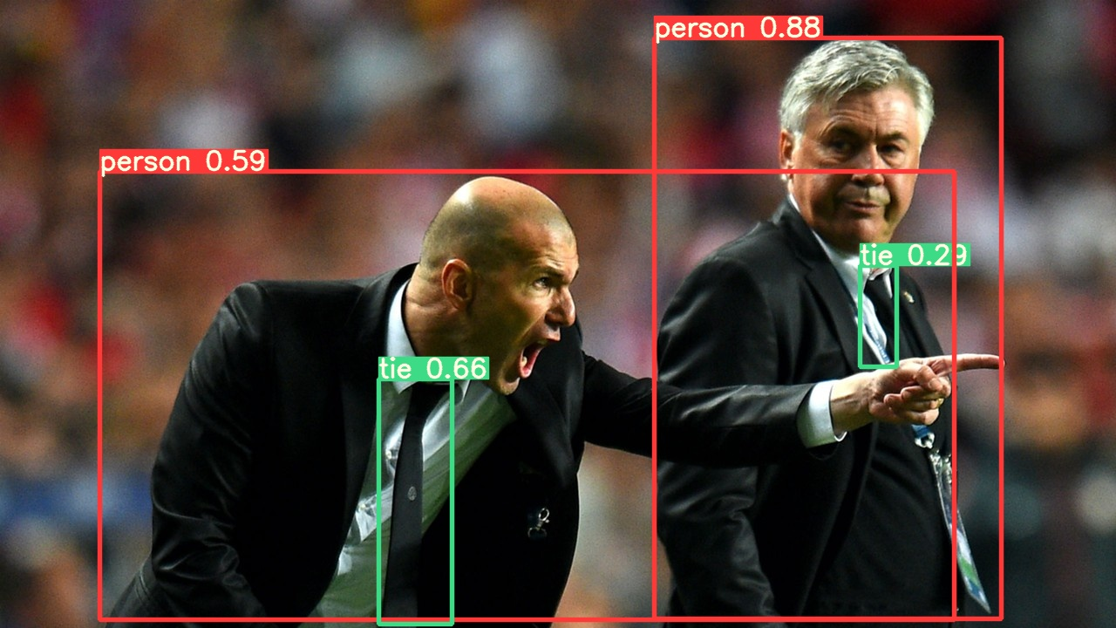
Object Detection with YOLOv5 Model^{[10]}

Slide 30
Implementation : Emotion detection Model
# Create a dataset using torchvision ImageFolder
test_dataset = torchvision.datasets.ImageFolder(root=data_path_test,
transform=transforms.Compose([transforms.Resize((128, 128)),
transforms.ToTensor()]))
# Create a DataLoader for the test dataset
test_loader = torch.utils.data.DataLoader(dataset=test_dataset,
batch_size=24,
shuffle=False)
# Function to evaluate the model for emotion, age, and gender classification
def evaluate_model(model, dataloader):
"""
Function for evaluating a classification model by printing/plotting classification report and confusion matrix
:param model: a pytorch trained model
:param dataloader: a pytorch DataLoader object, or any object that yields pytorch tensors
ready to be used by the model
:return: Predictions for emotion, age, and gender
"""
y_emotion = []
y_age = []
y_gender = []
device = torch.device('cuda' if torch.cuda.is_available() else 'cpu')
# Set the model in evaluation mode
model.eval()
model = model.to(device)
with torch.no_grad():
# Iterate over data.
for images, labels in tqdm.tqdm(dataloader):
images = images.to(device, dtype=torch.float32)
# Assuming your model has methods for predicting emotion, age, and gender
emotion_pred, age_pred, gender_pred = model(images)
# Append predictions to the lists
y_emotion.append(emotion_pred.to('cpu').numpy())
y_age.append(age_pred.to('cpu').numpy())
y_gender.append(gender_pred.to('cpu').numpy())
return y_emotion, y_age, y_gender
# Use the evaluate_model function to get predictions
y_pred_emotion, y_pred_age, y_pred_gender = evaluate_model(model, test_loader)
Including additional features such as emotion, age, and gender classifications can enhance the performance of the machine learning model. These features provide additional context that enables the model to better discern between different types of memes, including those with hateful content.
Memes often convey complex messages through a combination of text and images. Analyzing emotions in images and understanding the age and gender of individuals depicted can provide a more comprehensive understanding of the meme's content.
LIBRARIES : torch and torch.nn.functional (PyTorch): PyTorch is a popular deep learning library. It provides tools for building and training neural networks. torch.nn.functional contains a variety of functions for neural network operations.
tqdm: This library provides a fast, extensible progress bar for loops and other iterable computations.
numpy (np): NumPy is a library for numerical operations in Python. It provides support for large, multi-dimensional arrays and matrices, along with mathematical functions.
vision_utils: This appears to be a custom utility module for PyTorch-based computer vision tasks. It might contain custom functions or classes related to image processing and deep learning.
transforms (from torchvision): transforms is a module from the torchvision library, which is part of the PyTorch ecosystem. It provides common image transformations, such as resizing and tensor conversion.
shutil: This is a standard library module in Python used for file operations. In this case, it's used for copying image files.

Slide 31
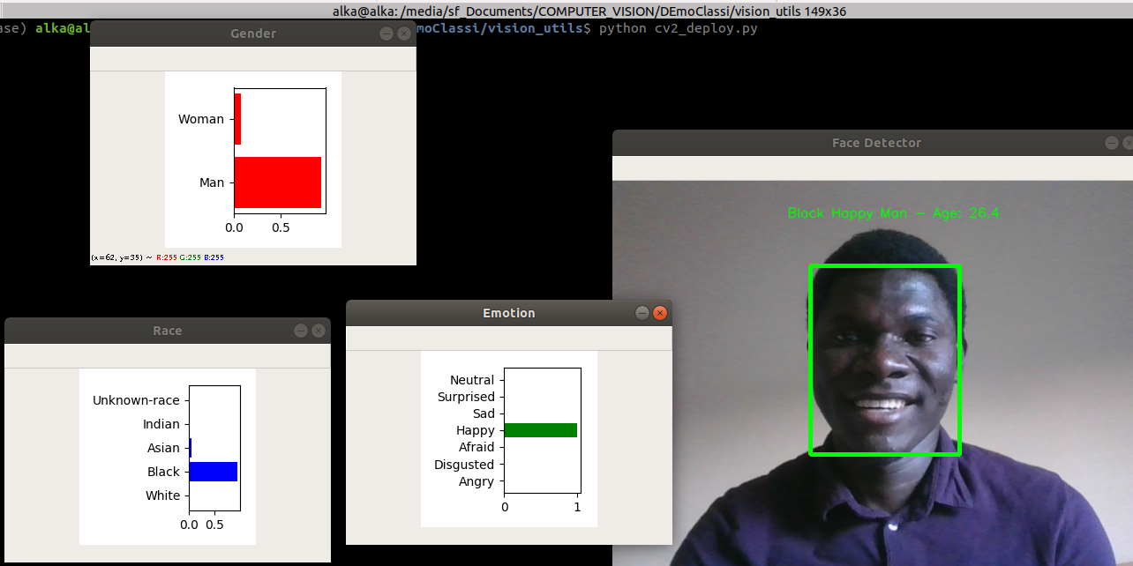
Illustration of Face Type Detection & Emotion detection Model
Image Input
Face Type
Detection
Model
Emotion
Detection
Model
Classification
Classification
Prediction
Race
Gender
Age
Emotion
White
Black
Asian
Indian
Unkown
Male
Female
0-100
Float
Happy
Sad
Afraid
Angry
Disgusted
Surprised
Neutral

Slide 32
Implementation : BERT
BERT, or Bidirectional Encoder Representations from Transformers, is a natural language processing (NLP) model introduced by Google in 2018. It belongs to the family of Transformer models, which are based on self-attention mechanisms and have shown significant success in various NLP tasks.
The key features of BERT include:
Bidirectional Context: Unlike traditional models that process text in a left-to-right or right-to-left manner, BERT considers both the left and right context simultaneously. This bidirectional approach helps the model understand the context of a word based on the entire sentence, capturing complex relationships and dependencies.
Pre-training: BERT is pre-trained on large amounts of unlabeled text data. During pre-training, it learns to predict missing words in a sentence (Masked Language Model or MLM objective) and understand relationships between different sentences (Next Sentence Prediction or NSP objective). This pre-training enables BERT to capture general language understanding.
Transformer Architecture: BERT utilizes the Transformer architecture, which includes self-attention mechanisms to weigh the importance of different words in a sentence when making predictions. This architecture allows BERT to capture long-range dependencies and relationships in text.
BERT is used to process and understand textual information, and its pre-trained weights are fine-tuned on the specific dataset for the classification task. The model's ability to capture contextual information and generalize well to diverse language patterns makes it a suitable choice for such tasks.

Slide 33
Implementation : BERT
# Training loop
for epoch in tqdm(range(1, epochs + 1)):
model.train() # Set the model to training mode
loss_train_total = 0
# Iterate over batches in the training data loader
progress_bar = tqdm(dataloader_train, desc=f'Epoch {epoch}', leave=False, disable=False)
for batch in progress_bar:
model.zero_grad() # Zero the gradients
batch = tuple(b.to(device) for b in batch) # Move batch to the device
inputs = {
'input_ids': batch[0],
'attention_mask': batch[1],
'labels': batch[2]
}
outputs = model(**inputs) # Get model outputs
# BERT returns loss and logits
loss = outputs[0]
loss_train_total += loss.item()
loss.backward() # Backpropagation
torch.nn.utils.clip_grad_norm_(model.parameters(), 1.0) # Clip gradients to prevent exploding gradients
optimizer.step()
scheduler.step()
progress_bar.set_postfix({'training_loss': '{:.3f}'.format(loss.item() / len(batch))})
# Save the model after each epoch
torch.save(model.state_dict(), f'/content/drive/MyDrive/NLP_Final_Project/models/BERT2_ft_epoch{epoch}.model')
# Print training statistics
tqdm.write(f'\nEpoch {epoch}')
loss_train_avg = loss_train_total / len(dataloader_train)
tqdm.write(f'Training loss: {loss_train_avg}')
# Evaluate on the validation set
val_loss, predictions, true_value = evaluate(dataloader_val)
val_AUC = auc(predictions, true_value)
tqdm.write(f'Validation loss: {val_loss}')
tqdm.write(f'AUC Score: {val_AUC}')
# Step 1: Load the Data
# ... (Loading data using Pandas)
# Step 2: Loading Tokenizer and Encoding our Data
# ... (Loading BERT tokenizer and encoding data)
# Step 3: Setting up BERT Pretrained Model
# ... (Initializing BERT model for sequence classification)
# Step 4: Creating Data Loaders
# ... (Creating data loaders using DataLoader)
# Step 5: Setting Up Optimizer and Scheduler
# ... (Setting up AdamW optimizer and linear scheduler)
# Step 6: Defining our Performance Metric
# ... (Defining AUC metric)
# Step 7: Creating our Training Loop
# Set random seed for reproducibility
seed_val = 17
random.seed(seed_val)
np.random.seed(seed_val)
torch.manual_seed(seed_val)
torch.cuda.manual_seed_all(seed_val) # if using GPU
# Move the model to the device (CPU or GPU)
device = torch.device('cuda' if torch.cuda.is_available() else 'cpu')
model.to(device)
# Define the optimizer and scheduler
optimizer = AdamW(model.parameters(), lr=1e-5, eps=1e-8)
scheduler = get_linear_schedule_with_warmup(optimizer, num_warmup_steps=0, num_training_steps=len(dataloader_train) * epochs)

Slide 34
# Evaluate on the validation set
val_loss, predictions, true_value = evaluate(dataloader_val)
val_AUC = auc(predictions, true_value)
tqdm.write(f'Validation loss: {val_loss}')
tqdm.write(f'AUC Score: {val_AUC}')
# Step 8: Loading and Evaluating our Model
# ... (Loading trained model and evaluating on final test set)
# Step 9: Visualization (Optional)
# ... (Plotting ROC curve using Plotly or Matplotlib)
LIBRARIES :
transformers:
Description: A library from Hugging Face Transformers ecosystem.
Use: Provides pre-trained NLP models (such as BERT), tokenization utilities, and fine-tuning tools.
torch:
Description: PyTorch, an open-source deep learning library.
Use: Used for building and training neural networks.
sklearn:
Description: A machine learning library in Python.
Use: Used for computing the ROC curve and AUC score for model evaluation.
tqdm:
Description: Library for creating progress bars in loops.
Use: Provides a visual indication of progress during lengthy computations, such as training epochs.
plotly:
Description: Interactive visualization library.
Use: Utilized for creating interactive plots, specifically the ROC curve in this context.
Implementation : BERT
# Training loop
for epoch in tqdm(range(1, epochs + 1)):
model.train() # Set the model to training mode
loss_train_total = 0
# Iterate over batches in the training data loader
progress_bar = tqdm(dataloader_train, desc=f'Epoch {epoch}', leave=False, disable=False)
for batch in progress_bar:
model.zero_grad() # Zero the gradients
batch = tuple(b.to(device) for b in batch) # Move batch to the device
inputs = {
'input_ids': batch[0],
'attention_mask': batch[1],
'labels': batch[2]
}
outputs = model(**inputs) # Get model outputs
# BERT returns loss and logits
loss = outputs[0]
loss_train_total += loss.item()
loss.backward() # Backpropagation
torch.nn.utils.clip_grad_norm_(model.parameters(), 1.0) # Clip gradients to prevent exploding gradients
optimizer.step()
scheduler.step()
progress_bar.set_postfix({'training_loss': '{:.3f}'.format(loss.item() / len(batch))})
# Save the model after each epoch
torch.save(model.state_dict(), f'/content/drive/MyDrive/NLP_Final_Project/models/BERT2_ft_epoch{epoch}.model')
# Print training statistics
tqdm.write(f'\nEpoch {epoch}')
loss_train_avg = loss_train_total / len(dataloader_train)
tqdm.write(f'Training loss: {loss_train_avg}')
# Step 1: Load the Data
# ... (Loading data using Pandas)
# Step 2: Loading Tokenizer and Encoding our Data
# ... (Loading BERT tokenizer and encoding data)
# Step 3: Setting up BERT Pretrained Model
# ... (Initializing BERT model for sequence classification)
# Step 4: Creating Data Loaders
# ... (Creating data loaders using DataLoader)
# Step 5: Setting Up Optimizer and Scheduler
# ... (Setting up AdamW optimizer and linear scheduler)
# Step 6: Defining our Performance Metric
# ... (Defining AUC metric)
# Step 7: Creating our Training Loop
# Set random seed for reproducibility
seed_val = 17
random.seed(seed_val)
np.random.seed(seed_val)
torch.manual_seed(seed_val)
torch.cuda.manual_seed_all(seed_val) # if using GPU
# Move the model to the device (CPU or GPU)
device = torch.device('cuda' if torch.cuda.is_available() else 'cpu')
model.to(device)
# Define the optimizer and scheduler
optimizer = AdamW(model.parameters(), lr=1e-5, eps=1e-8)
scheduler = get_linear_schedule_with_warmup(optimizer, num_warmup_steps=0, num_training_steps=len(dataloader_train) * epochs)

Slide 35
Implementation : OCR (Optical Character Recognition)
Optical Character Recognition (OCR) is a technology that converts different types of documents, such as scanned paper documents, PDFs, or images captured by a digital camera, into editable and searchable data. OCR extracts text from these documents and translates it into machine-readable text.
In the context of hateful meme detection, OCR is likely used to extract text content from images. Many memes contain textual elements, and analyzing this text can provide valuable information for the classification task. OCR allows the algorithm to "read" the text present in the meme images, which can be combined with other features (such as image content or metadata) for a more comprehensive analysis.
This technique here is used as : 1) Multimodal Analysis: Combining text information with other features, such as image content, allows for a multimodal approach to meme analysis. This holistic approach leverages both visual and textual information for more accurate classification.
2) Data Preprocessing: OCR might be used as a preprocessing step to convert image data into a format that can be easily integrated into models designed for text-based analysis.
3) Enhanced Understanding: OCR aids in understanding the meme content by providing the actual text present in the image. This understanding is essential for accurately categorizing memes as hateful or non-hateful.
LIBRARIES :
easyocr Library:
Use: easyocr is a deep learning-based OCR library that simplifies optical character recognition on images. It recognizes text in images and provides an easy-to-use interface for this task.
cv2 (OpenCV) Library:
Use: OpenCV is a computer vision library used for various image processing tasks. In this context, it is utilized for image manipulation, such as reading, blurring, and thresholding images.
os Library:
Use: The os module provides a way to interact with the operating system. It is used here to list files in a directory.
google.colab.patches Library:
Use: This library contains patches and utilities specific to the Google Colab environment. In this context, it is used for displaying images.
csv Library:
Use: The csv module is used for reading from and writing to CSV files. It helps in organizing and saving the transcribed text data.
These libraries collectively enable the optical character recognition of text in images, allowing the extraction and further processing of textual information from meme images.

Slide 36
Implementation : OCR (Optical Character Recognition)
# Step 1: Initialize OCR reader
reader = easyocr.Reader(['en'], gpu=False)
# Step 2: Read text from an image using OCR
result = reader.readtext(image_path)
test = result
# Step 3: Extract text from the OCR result
general_meme_list = []
for i in range(len(test)):
meme_text = []
meme_text.append(test[i][1])
str_meme = ''.join(meme_text)
general_meme_list.append(str_meme)
# Step 4: Combine extracted text into a single string
str_list = ' '.join(general_meme_list)
print(str_list)
# Step 5: Preprocess image and apply OCR on the preprocessed images
image = cv2.imread(image_path, 0)
image = cv2.medianBlur(image, 5)
binarized_image = cv2.adaptiveThreshold(image, 255, cv2.ADAPTIVE_THRESH_GAUSSIAN_C, cv2.THRESH_BINARY, 11, 2)
# ... (additional image preprocessing steps)
# Step 6: Apply OCR on the preprocessed images
result = reader.readtext(image)
result = reader.readtext(th1)
# ... (additional OCR on different image preprocessing approaches)
# Step 7: Extract text from OCR result
transcribed_memes_list = []
for item in range(len(file_names)):
image_path = unzipped_image_folder_path + file_names[item]
reader = easyocr.Reader(['en'], gpu=True)
result = reader.readtext(image_path)
test = result
full_meme_list = []
for i in range(len(test)):
meme_text = []
meme_text.append(test[i][1])
str_meme = ''.join(meme_text)
full_meme_list.append(str_meme)
str_list = ''.join(full_meme_list)
transcribed_memes_list.append(str_list)
# Step 8: Create CSV data for transcribed memes
csv_data = []
for i, row in train_data.iterrows():
# Adding data to the CSV list
csv_data.append({
"seq_ids": i + 1,
"id": row["id"],
"Fulltext": row["text"],
"text": row["text"],
"img": row["img"],
"clean_text": row["text"]
})
# Step 9: Write CSV data to a file
csv_file_path = "/content/drive/MyDrive/NLP_Final_Project/new_merged.csv"
with open(csv_file_path, 'w', newline='') as csv_file:
fieldnames = ["seq_ids", "id", "Fulltext", "text", "img", "clean_text"]
writer = csv.DictWriter(csv_file, fieldnames=fieldnames)
# Write header
writer.writeheader()
# Write data rows
writer.writerows(csv_data)
print(f"CSV file '{csv_file_path}' created successfully.")

Slide 37

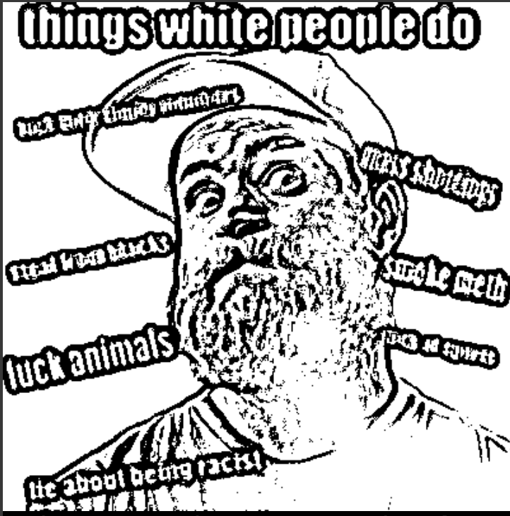
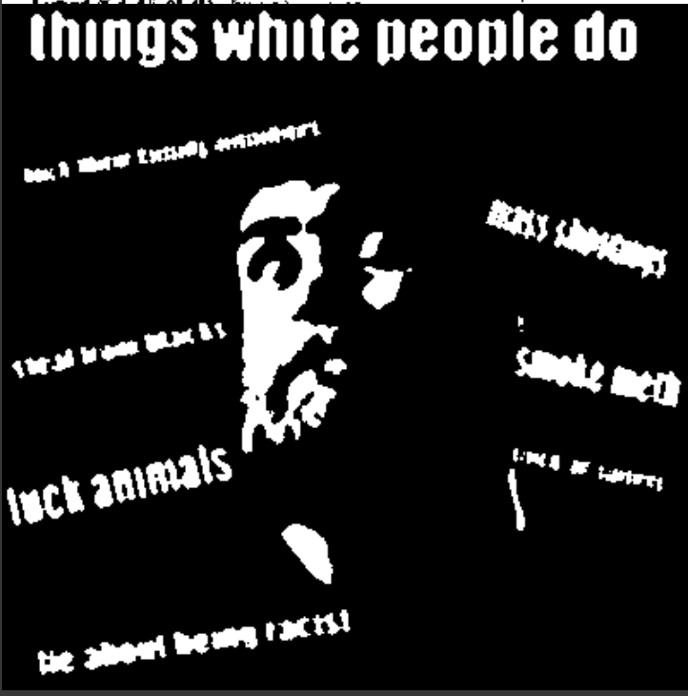
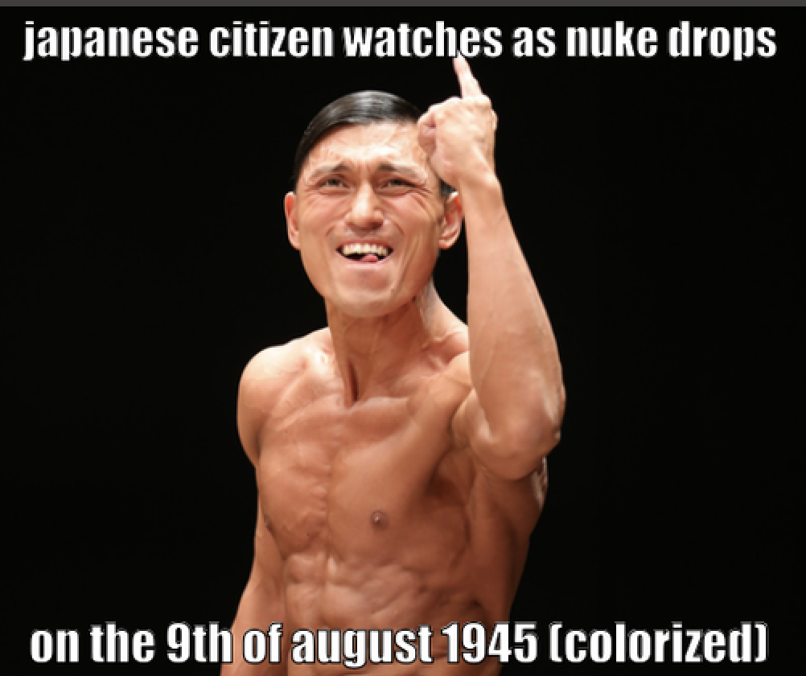
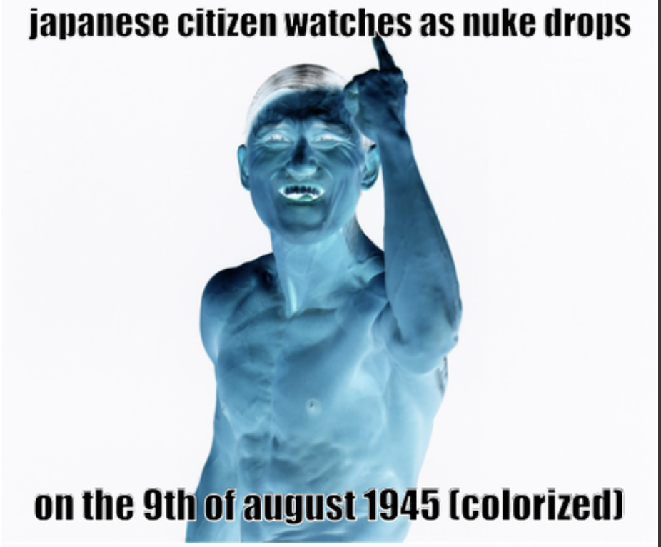
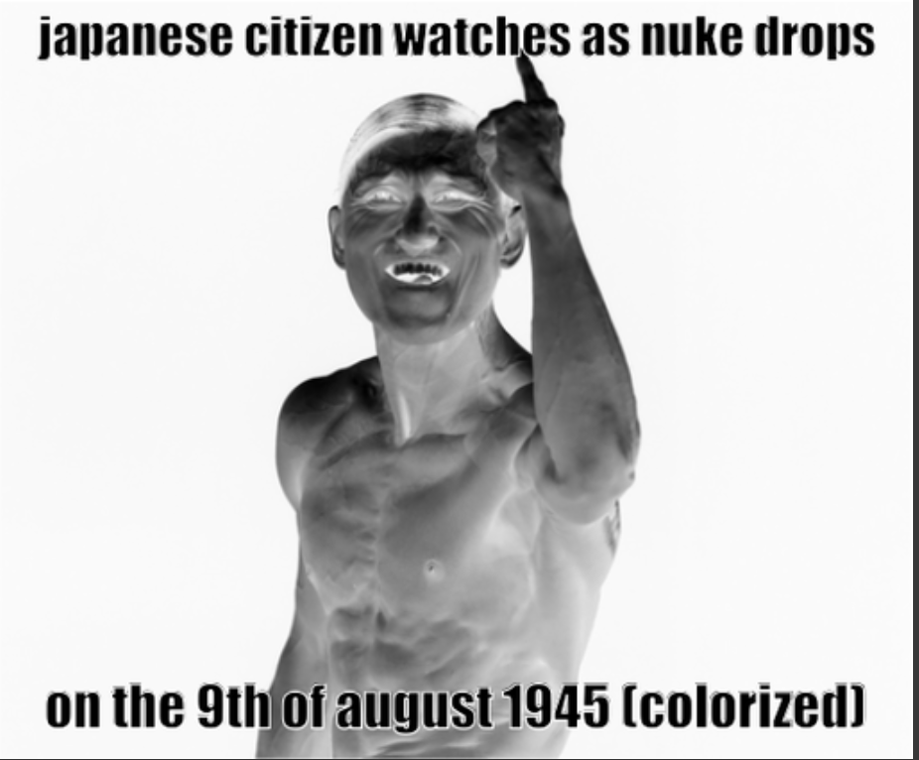
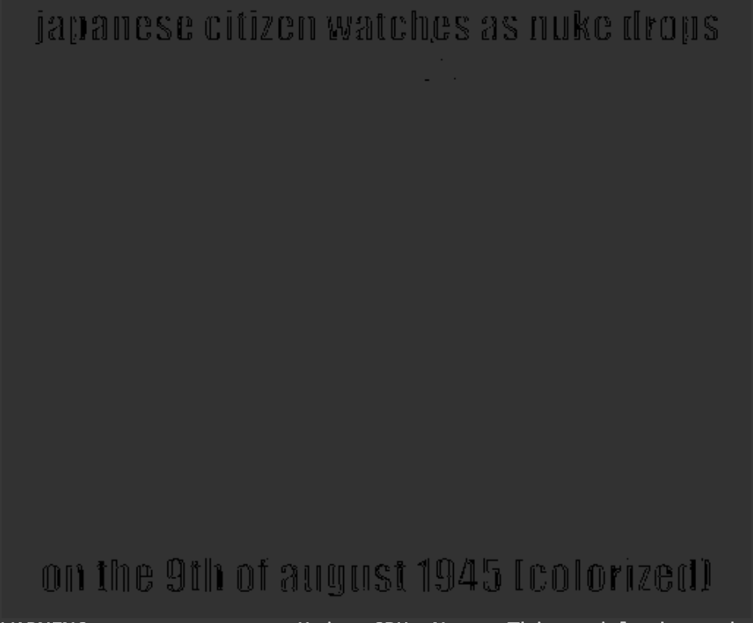
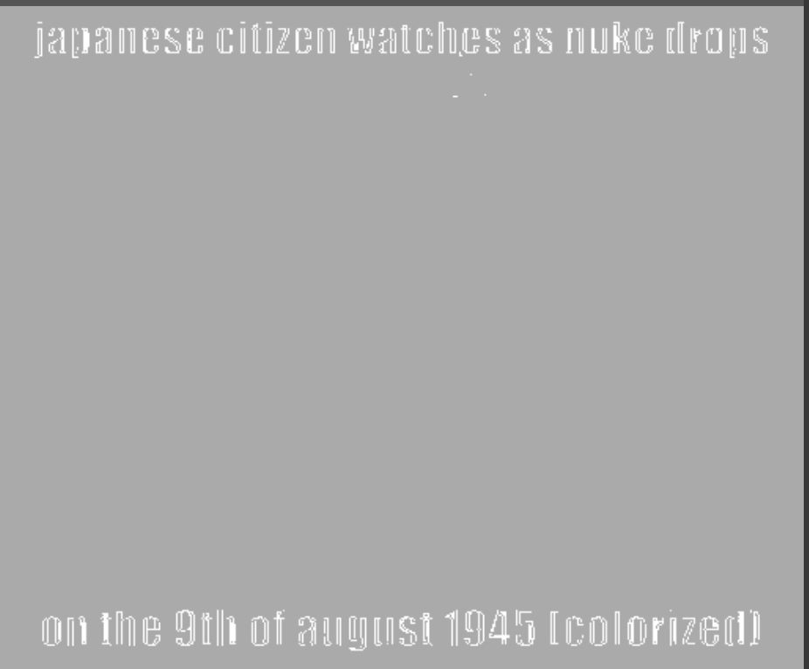
Implementation : OCR (Optical Character Recognition)
-->
-->
-->
-->
-->
-->

Slide 38
Implementation : TF_IDF(Term Frequency-Inverse Document Frequency)
TF-IDF (Term Frequency-Inverse Document Frequency):
TF-IDF is a numerical statistic that reflects the importance of a word in a document relative to a collection of documents (corpus). It is widely used in information retrieval and text mining to evaluate the importance of words in a document. TF-IDF combines two metrics: Term Frequency (TF), which measures the frequency of a word in a document, and Inverse Document Frequency (IDF), which measures the rarity of a word across the entire document collection. The goal is to emphasize words that are frequent in a document but not common across all documents, identifying key terms that distinguish one document from another.
Choice of Models (SVM, LR, KNN) for Hateful Meme Detection:
Support Vector Machine (SVM):
SVM is a supervised machine learning algorithm used for classification and regression tasks. It works by finding a hyperplane that best separates data into different classes.
Why SVM: SVM is effective in high-dimensional spaces, making it suitable for text classification problems like hateful meme detection. It can handle non-linear relationships and is less prone to overfitting. SVM is well-suited for binary classification tasks.
Logistic Regression (LR):
Logistic Regression is a statistical model used for binary classification. It predicts the probability that a given instance belongs to a particular class.
Why LR: Logistic Regression is a simple yet effective model for binary classification tasks. It provides probabilities, making it interpretable, and is computationally efficient. LR is suitable for problems where the relationship between features and the log-odds of the response variable is approximately linear.
K-Nearest Neighbors (KNN):
KNN is a non-parametric, lazy learning algorithm used for classification and regression. It classifies data points based on the majority class of their k-nearest neighbors.
Why KNN: KNN is a versatile algorithm that doesn't make strong assumptions about the underlying data distribution. It can capture complex patterns and is sensitive to local variations. KNN can be effective when dealing with non-linear relationships and irregular decision boundaries.

Slide 39
Implementation : TF_IDF(Term Frequency-Inverse Document Frequency)
SVM, LR, and KNN are commonly used for text classification tasks due to their ability to handle high-dimensional data and non-linear relationships.
SVM provides a robust separation between classes.
LR is a simple and interpretable model, making it suitable for cases where feature interpretation is important.
KNN is flexible and can capture intricate relationships, which may be beneficial in text data with non-linear patterns.
The choice of these models allows for a comprehensive exploration of different approaches, considering both simplicity and complexity, to effectively classify hateful memes in the given context.
Libraries which are used in this are :
1)KFold (from sklearn.model_selection):
Description: KFold is a cross-validation technique that divides a dataset into k subsets, or "folds," for training and testing machine learning models.
Use in Code: Used for cross-validation in grid search to evaluate model performance.
2)GridSearchCV (from sklearn.model_selection):
Description: GridSearchCV is a method for systematically working through multiple combinations of hyperparameter values to find the best parameters for a model.
Use in Code: Applied for hyperparameter tuning in machine learning models.
3)ConfusionMatrix (from sklearn.metrics):
Description: ConfusionMatrix is a tool for summarizing the performance of a classification algorithm by displaying the number of true positive, true negative, false positive, and false negative predictions.
Use in Code: Utilized for evaluating and visualizing the confusion matrices of different machine learning models.
4)AccuracyScore (from sklearn.metrics):
Description: AccuracyScore is a metric that measures the accuracy of a classification model by calculating the ratio of correctly predicted instances to the total instances.
Use in Code: Employed for calculating the accuracy of different machine learning models.

Slide 40
Implementation : TF_IDF
# Import necessary libraries
import pandas as pd
from sklearn.feature_extraction.text import TfidfVectorizer
from sklearn.preprocessing import StandardScaler
from sklearn.model_selection import KFold, GridSearchCV
from sklearn.linear_model import LogisticRegression
from sklearn.naive_bayes import MultinomialNB
from sklearn.ensemble import RandomForestClassifier
from sklearn.svm import SVC
from sklearn.neighbors import KNeighborsClassifier
from sklearn.metrics import roc_curve, auc, accuracy_score, confusion_matrix
import matplotlib.pyplot as plt
# Load data
train_data = pd.read_csv(path+'new_merged.csv')
# Extract text
text = []
for i in train_data['text']:
text.append(i)
# TF-IDF Vectorization
tf_transfomer = TfidfVectorizer(stop_words='english', decode_error='ignore')
X_train_counts_tf = tf_transfomer.fit_transform(text)
scaler = StandardScaler(with_mean=False)
x_train_counts_tf = scaler.fit_transform(X_train_counts_tf)
# Train-test split
train_cut = 8000
# Define models and parameters for grid search
num_folds = 10
seed = 7
scoring = 'accuracy'
param_grid = {}
# Logistic Regression
param_grid['C'] = [0.1, 0.2, 0.3, 0.5, 0.8, 1, 5, 13, 15]
param_grid['solver'] = ['newton-cg', 'lbfgs', 'liblinear', 'sag', 'saga']
model_lr = LogisticRegression(max_iter=10000)
grid_lr = GridSearchCV(estimator=model_lr, param_grid=param_grid, scoring=scoring, cv=KFold(n_splits=num_folds, random_state=seed, shuffle=True))
grid_result_lr = grid_lr.fit(X=X_train_counts_tf, y=train_data['label'])
best_params_lr = grid_result_lr.best_params_
# Multinomial Naive Bayes
param_grid['alpha'] = [0.001, 0.01, 0.05, 0.1, 0.5, 1, 1.5, 2]
model_nb = MultinomialNB()
grid_nb = GridSearchCV(estimator=model_nb, param_grid=param_grid, scoring=scoring, cv=KFold(n_splits=num_folds, random_state=seed, shuffle=True))
grid_result_nb = grid_nb.fit(X=X_train_counts_tf[:train_cut], y=train_data['label'])
best_params_nb = grid_result_nb.best_params_
# Random Forest
param_grid['n_estimators'] = [10, 50, 100, 150, 200]
param_grid['max_features'] = ['auto', 'sqrt', 'log2']
param_grid['max_depth'] = [3, 4, 5, 6, 7, 8, 9, 10]
model_rf = RandomForestClassifier()
grid_rf = GridSearchCV(estimator=model_rf, param_grid=param_grid, scoring=scoring, cv=KFold(n_splits=num_folds, random_state=seed, shuffle=True))
grid_result_rf = grid_rf.fit(X=X_train_counts_tf[:train_cut], y=train_data['label'])
best_params_rf = grid_result_rf.best_params_
# Support Vector Machine (SVM)
param_grid = {'C': [0.1, 0.2, 0.3, 0.5, 0.8, 1, 5, 13, 15, 20]}
model_svm = SVC(max_iter=100000)
grid_svm = GridSearchCV(estimator=model_svm, param_grid=param_grid, scoring=scoring, cv=KFold(n_splits=num_folds, random_state=seed, shuffle=True))
grid_result_svm = grid_svm.fit(X=X_train_counts_tf, y=train_data['label'])
best_params_svm = grid_result_svm.best_params_

Slide 41
Implementation : TF_IDF
# K-Nearest Neighbors (KNN)
param_grid['n_neighbors'] = [3, 5, 10, 20, 30]
param_grid['weights'] = ['uniform', 'distance']
model_knn = KNeighborsClassifier()
grid_knn = GridSearchCV(estimator=model_knn, param_grid=param_grid, scoring=scoring, cv=KFold(n_splits=num_folds, random_state=seed, shuffle=True))
grid_result_knn = grid_knn.fit(X=X_train_counts_tf[:train_cut], y=train_data['label'])
best_params_knn = grid_result_knn.best_params_
# Evaluate models and plot ROC curves
models = {
'LR': LogisticRegression(C=best_params_lr['C'], solver=best_params_lr['solver']),
'SVM': SVC(C=best_params_svm['C']),
'CART': RandomForestClassifier(max_depth=best_params_rf['max_depth'], max_features=best_params_rf['max_features'], n_estimators=best_params_rf['n_estimators']),
'MNB': MultinomialNB(alpha=best_params_nb['alpha']),
'KNN': KNeighborsClassifier(n_neighbors=best_params_knn['n_neighbors'], weights=best_params_knn['weights'])
}
# Train models
for name, model in models.items():
model.fit(X_train_counts_tf[:train_cut], train_data['label'][:train_cut])
# ROC Curve
fig, axes = plt.subplots(nrows=2, ncols=3, figsize=(15, 10))
for (name, model), ax in zip(models.items(), axes.flatten()):
y_score = model.decision_function(X_train_counts_tf[train_cut:])
fpr, tpr, threshold = roc_curve(train_data['label'][train_cut:], y_score)
roc_auc = auc(fpr, tpr)
ax.plot(fpr, tpr, color='darkorange', lw=2, label='ROC curve (area = %0.2f)' % roc_auc)
ax.plot([0, 1], [0, 1], color='navy', lw=2, linestyle='--')
ax.set_xlim([0.0, 1.0])
ax.set_ylim([0.0, 1.05])
ax.set_xlabel('False Positive Rate')
ax.set_ylabel('True Positive Rate')
ax.set_title(f'ROC for {name}')
ax.legend(loc="lower right")
plt.tight_layout()
plt.savefig('TF_IDF_ROC.jpg')
plt.show()
# Confusion Matrix and Metrics
for name, model in models.items():
predictions = model.predict(X_train_counts_tf[train_cut:])
matrix = confusion_matrix(train_data['label'][train_cut:], predictions)
precision = matrix[1, 1] / (matrix[0, 1] + matrix[1, 1])
recall = matrix[1, 1] / (matrix[1, 1] + matrix[1, 0])
print(f'{name} Matrix:')
print(matrix)
print(f'Precision: {precision}')
print(f'Recall: {recall}')
print('---')

Slide 42
Implementation : RESNET
ResNet, short for Residual Network, is a type of deep neural network architecture designed to address the challenges of training very deep networks. It was introduced by researchers at Microsoft Research in the paper "Deep Residual Learning for Image Recognition" by Kaiming He, Xiangyu Zhang, Shaoqing Ren, and Jian Sun, presented at the IEEE Conference on Computer Vision and Pattern Recognition (CVPR) in 2016.
Regularization:
regularizers: Module containing regularization functions like L1 and L2 regularization.
Image Data Generation:
ImageDataGenerator: Generates batches of augmented data for training neural networks.
Callbacks:
EarlyStopping: Stops training when a monitored metric has stopped improving.
LearningRateScheduler: Dynamically adjusts the learning rate during training.
These libraries collectively provide the tools needed to define, train, and evaluate a deep learning model (ResNet-50), including data augmentation, regularization, optimization, and evaluation metrics. The model is trained on image data, and its performance is evaluated using an SVM classifier and confusion matrix metrics from scikit-learn.
Why ResNet for Hateful Meme Classification:
Capacity to Handle Complex Data:
ResNet's ability to handle very deep networks makes it suitable for complex tasks such as image classification, where extracting hierarchical features is crucial.
Feature Learning:
Residual connections allow the model to learn both low-level and high-level features effectively.
For meme classification, understanding both fine-grained details and contextual information is essential.
Avoiding Vanishing Gradient:
The use of skip connections helps mitigate the vanishing gradient problem, making it feasible to train deep networks.
This is especially important when dealing with large and diverse datasets like those encountered in meme classification.
Transfer Learning:
Pre-trained versions of ResNet on large image datasets (e.g., ImageNet) can be used for transfer learning.
This allows leveraging knowledge gained from pre-training on generic image data to improve performance on specific tasks like hateful meme classification.
In the provided code snippet, a ResNet-50 model is used for feature extraction. The features extracted from the ResNet model are then fed into an SVM classifier for the task of hateful meme detection. The combination of deep feature learning from ResNet and the discriminative power of SVM can be effective in capturing complex patterns in image data, including those relevant for detecting hateful content in memes.

Slide 43
Implementation : RESNET
# Combine the above functions to build a 50-layer ResNet
def resnet50():
input_im = Input(shape=(224, 224, 3)) # Image size
x = ZeroPadding2D(padding=(3, 3))(input_im)
# 1st stage
# Here we perform maxpooling
x = Conv2D(64, kernel_size=(7, 7), strides=(2, 2))(x)
x = BatchNormalization()(x)
x = Activation(activations.relu)(x)
x = MaxPooling2D((3, 3), strides=(2, 2))(x)
# 2nd stage
# From here on, only conv block and identity block, no pooling
x = res_conv(x, s=1, filters=(64, 256))
x = res_identity(x, filters=(64, 256))
x = res_identity(x, filters=(64, 256))
# 3rd stage
x = res_conv(x, s=2, filters=(128, 512))
x = res_identity(x, filters=(128, 512))
x = res_identity(x, filters=(128, 512))
x = res_identity(x, filters=(128, 512))
# 4th stage
x = res_conv(x, s=2, filters=(256, 1024))
x = res_identity(x, filters=(256, 1024))
x = res_identity(x, filters=(256, 1024))
x = res_identity(x, filters=(256, 1024))
x = res_identity(x, filters=(256, 1024))
x = res_identity(x, filters=(256, 1024))
# 5th stage
x = res_conv(x, s=2, filters=(512, 2048))
x = res_identity(x, filters=(512, 2048))
x = res_identity(x, filters=(512, 2048))
# Define identity unit for the network
def res_identity(x, filters):
x_skip = x # This will be used for addition with the residual block
f1, f2 = filters
# First block
x = Conv2D(f1, kernel_size=(1, 1), strides=(1, 1), padding='valid', kernel_regularizer=regularizers.l2(0.001))(x)
x = BatchNormalization()(x)
x = Activation(activations.relu)(x)
# Second block (bottleneck, but size kept same with padding)
x = Conv2D(f1, kernel_size=(3, 3), strides=(1, 1), padding='same', kernel_regularizer=regularizers.l2(0.001))(x)
x = BatchNormalization()(x)
x = Activation(activations.relu)(x)
# Third block activation used after adding the input
x = Conv2D(f2, kernel_size=(1, 1), strides=(1, 1), padding='valid', kernel_regularizer=regularizers.l2(0.001))(x)
x = BatchNormalization()(x)
# Add the input
x = Add()([x, x_skip])
x = Activation(activations.relu)(x)
return x
# Define convolutional layers
def res_conv(x, s, filters):
x_skip = x
f1, f2 = filters
# First block
x = Conv2D(f1, kernel_size=(1, 1), strides=(s, s), padding='valid', kernel_regularizer=regularizers.l2(0.001))(x)
# When s = 2, it is like downsizing the feature map
x = BatchNormalization()(x)
x = Activation(activations.relu)(x)
# Second block
x = Conv2D(f1, kernel_size=(3, 3), strides=(1, 1), padding='same', kernel_regularizer=regularizers.l2(0.001))(x)
x = BatchNormalization()(x)
x = Activation(activations.relu)(x)
# Third block
x = Conv2D(f2, kernel_size=(1, 1), strides=(1, 1), padding='valid', kernel_regularizer=regularizers.l2(0.001))(x)
x = BatchNormalization()(x)
# Shortcut
x_skip = Conv2D(f2, kernel_size=(1, 1), strides=(s, s), padding='valid', kernel_regularizer=regularizers.l2(0.001))(x_skip)
x_skip = BatchNormalization()(x_skip)
# Add
x = Add()([x, x_skip])
x = Activation(activations.relu)(x)
return x

Slide 44
Implementation : RESNET
# Ends with average pooling and dense connection
x = AveragePooling2D((2, 2), padding='same')(x)
x = Flatten()(x)
x = Dense(2, activation='softmax', kernel_initializer='he_normal', kernel_regularizer=regularizers.l2(0.01),
activity_regularizer=regularizers.l1(0.01))(x)
model = Model(inputs=input_im, outputs=x, name='Resnet50')
return model
# Define learning rate decay callback
def lrdecay(epoch):
lr = 1e-3
if epoch > 180:
lr *= 0.5e-3
elif epoch > 160:
lr *= 1e-3
elif epoch > 120:
lr *= 1e-2
elif epoch > 80:
lr *= 1e-1
return lr
# Create ResNet-50 model
resnet50_model = resnet50()
# Show the structure of the network
resnet50_model.summary()
# Add optimizer, loss function, and quality metrics to the model
resnet50_model.compile(loss='categorical_crossentropy', optimizer=Adam(learning_rate=1e-4), metrics=['acc'])
# Define callbacks
lrdecay = LearningRateScheduler(lrdecay) # Learning rate decay
estop = tf.keras.callbacks.EarlyStopping(monitor='val_acc', patience=15, mode='max') # Early stopping
# Run the model
resnet_train = resnet50_model.fit(train_set_conv, epochs=20, steps_per_epoch=train_im.shape[0] / batch_size,
validation_steps=test_im.shape[0] / batch_size, validation_data=valid_set_conv,
callbacks=[lrdecay, estop])
# Extract the last dense layer from the trained model
representation_model = Model(inputs=resnet50_model.inputs, outputs=resnet50_model.get_layer('flatten').output)
# Apply the layer to every observation
representation_model_output = representation_model.predict(train_im)
representation_model_output_test = representation_model.predict(test_im)
# Train an SVM classifier
from sklearn.svm import SVC
svm = SVC(kernel='rbf', C=0.1)
svm.fit(representation_model_output, train_lab)
predicts = svm.predict(representation_model_output_test)
TensorFlow and Keras:
tf.keras.layers: Provides a collection of standard layers for building neural networks in TensorFlow.
tf.keras.models: Used for creating and training models.
Convolutional Layers:
Conv2D: Convolutional layer for 2D spatial convolution over images.
ZeroPadding2D: Zero-padding layer to add rows and columns of zeros to the input.
MaxPooling2D: Max pooling layer for spatial data.
Normalization and Activation Layers:
BatchNormalization: Applies batch normalization to the input.
Activation: Applies an activation function (in this case, ReLU).
Pooling Layers:
AveragePooling2D: Average pooling layer for spatial data.
Dense Layer:
Dense: Fully connected layer with a specified number of output units and activation function.
Model Building and Compilation:
Model: The core Keras model class. It is used to define a model with input and output layers.
Adam: An optimization algorithm used for training the neural network.
LearningRateScheduler: Allows dynamic learning rate scheduling during training.
EarlyStopping: Stops training when a monitored metric has stopped improving.

Slide 45
Image Features
II) Multimodal Model Outline
Text Features
Face
Extraction
New Tags
From BERT
Object Detection
Face Type/
Emotion Detection
Classification
From RCNN

Slide 46
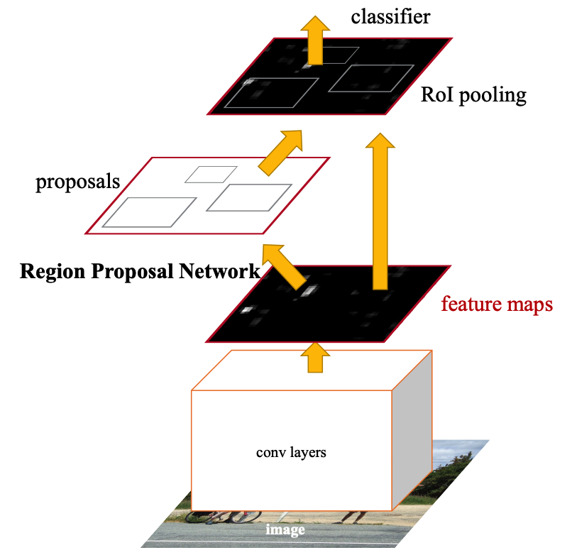
Implementation : VisualBERT
VisualBERT^{[12]} integrates BERT^{[8]}, a Transformer-based model for natural language processing, and pretrained object proposals systems Faster-RCNN^{[13]} to be applied to a variety of vision-and-language tasks.
In addition to all the components of BERT, a set of visual embeddings are included in Visual Bert, F, to model an image. Each f ∈ F corresponds to a bounding region in the image, derived from an object detector .
Person 0.996
Water Cup 0.97

Slide 47
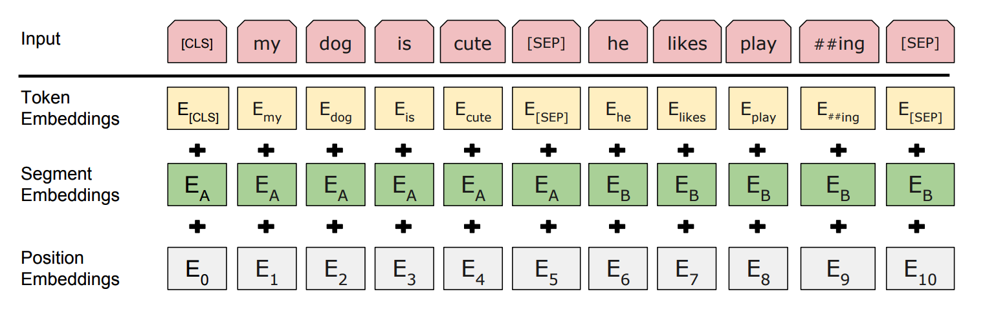
Visual Bert-Based Classifier: Input of Text
All of the subwords in an input sentence are mapped to a set of embeddings, E. Each embedding e ∈ E is computed as the sum of
1) a token embedding et, specific to the subword,
2) a segment embedding es, indicating which part of text the token comes from (e.g., the hypothesis from an entailment pair)
3) a position embedding ep, indicating the position of the token in the sentence.

Slide 48
Implementation : VisualBERT
# Get Visual Embeddings
try:
img = example['image']
img = Image.open(os.path.join('hateful_memes', img))
img = np.array(img)
img = img[...,:3]
inputs = feature_extractor(images=img, return_tensors="pt")
outputs = feature_model(**inputs.to('cuda'))
visual_embeds = outputs.last_hidden_state
visual_embeds = visual_embeds.cpu()
except:
visual_embeds = np.zeros(shape=(197, 768), dtype=float)
visual_attention_mask = torch.ones(visual_embeds.shape[:-1], dtype=torch.int64)
visual_token_type_ids = torch.ones(visual_embeds.shape[:-1], dtype=torch.int64)
inputs={"input_ids": tokens.squeeze(),
"attention_mask": attn_mask.squeeze(),
"token_type_ids": token_type_ids.squeeze(),
"visual_embeds": visual_embeds.squeeze(),
"visual_token_type_ids": visual_token_type_ids.squeeze(),
"visual_attention_mask": visual_attention_mask.squeeze(),
"label": targets.squeeze()
}
return inputs
def __getitem__(self, index):
inputs = self.tokenize_data(self.dataset[index])
if self.print_text:
for k in inputs.keys():
print(k, inputs[k].shape, inputs[k].dtype)
return inputs
# Example usage
dataset = HatefulMemesData(df_val, tokenizer, 50, True)
example1 = dataset[100]
# Assuming you have a list or array containing your target labels
y_train = df_train["label"].values.tolist()
# Use compute_class_weight to calculate class weights
class_weights = class_weight.compute_class_weight(
class_weight='balanced',
classes=np.unique(y_train),
y=y_train
)
class HatefulMemesData(Dataset):
def __init__(self, df, tokenizer, sequence_length, print_text=False):
self.sequence_length = sequence_length
self.tokenizer = tokenizer
self.print_text = print_text
texts = df["text"].values.tolist()
labels = df["label"].values.tolist()
images = df["img"].values.tolist()
ids = df["idx"].values.tolist()
self.dataset = []
for i, inp in enumerate(texts):
self.dataset.append({"text": inp, "label": labels[i], 'idx': ids[i], 'image': images[i]})
def __len__(self):
return len(self.dataset)
def tokenize_data(self, example):
idx = example['idx']
idx = [idx] if isinstance(idx, str) else idx
encoded_dict = tokenizer(example['text'], padding='max_length', max_length=self.sequence_length, truncation=True, return_tensors='pt')
tokens = encoded_dict['input_ids']
token_type_ids = encoded_dict['token_type_ids']
attn_mask = encoded_dict['attention_mask']
targets = torch.tensor(example['label']).type(torch.int64)
from datasets import list_metrics, load_metric
# List available metrics
metrics_list = list_metrics()
print(metrics_list)
# Load specific metrics
acc_metric = load_metric('accuracy')
f1_metric = load_metric('f1')
precision_metric = load_metric('precision')
recall_metric = load_metric('recall')
import torch
import os
import numpy as np
from transformers import ViTFeatureExtractor, ViTModel
from PIL import Image
from torch.utils.data import Dataset
# Load ViT model and feature extractor
feature_extractor = ViTFeatureExtractor.from_pretrained('google/vit-base-patch16-224-in21k')
feature_model = ViTModel.from_pretrained('google/vit-base-patch16-224-in21k').to('cuda')

Slide 49
Implementation : VisualBERT
# Extract pooled output and apply dropout
pooled_output = outputs[1]
pooled_output = self.dropout(pooled_output)
# Pass through classification layer
logits = self.cls(pooled_output)
reshaped_logits = logits.view(-1, self.num_labels)
# Calculate loss using CrossEntropyLoss with class weights
loss = self.loss_fct(reshaped_logits, labels.view(-1))
return loss, reshaped_logits
# Instantiate and move the model to GPU
model = VisualBERTClassifier().to('cuda')
# Define metric name for the best model checkpoint
metric_name = "auroc"
# Define training arguments
args = TrainingArguments(
output_dir="model-checkpoint",
seed=110,
evaluation_strategy="steps",
learning_rate=1e-5,
per_device_train_batch_size=batch_size,
per_device_eval_batch_size=batch_size,
num_train_epochs=100,
weight_decay=0.05,
load_best_model_at_end=True,
metric_for_best_model=metric_name,
eval_steps=50,
save_steps=500,
fp16=False,
gradient_accumulation_steps=2
)
# Load VisualBert configuration
configuration = VisualBertConfig.from_pretrained('uclanlp/visualbert-nlvr2-coco-pre',
hidden_dropout_prob=0.3, attention_probs_dropout_prob=0.3)
# Load VisualBert model
model = VisualBertModel.from_pretrained('uclanlp/visualbert-nlvr2-coco-pre', config=configuration)
# Additional layers for classification
self.embed_cls = nn.Linear(768, 1024)
self.num_labels = 2
self.dropout = nn.Dropout(0.3)
self.cls = nn.Linear(768, self.num_labels)
# Define class weights for loss function
self.weight = torch.FloatTensor([class_weights])
# Define CrossEntropyLoss with weighted class samples
n_samples = [5178, 2849]
normed_weights = [1 - (x / sum(n_samples)) for x in n_samples]
self.loss_fct = CrossEntropyLoss(weight=torch.FloatTensor(normed_weights))
def forward(self, input_ids, attention_mask, token_type_ids, visual_embeds, visual_attention_mask,
visual_token_type_ids, labels):
# Apply linear layer to visual embeddings
visual_embeds_cls = self.embed_cls(visual_embeds)
# Pass inputs through VisualBERT model
outputs = self.visualbert(
input_ids,
attention_mask=attention_mask,
token_type_ids=token_type_ids,
visual_embeds=visual_embeds_cls,
visual_attention_mask=visual_attention_mask,
visual_token_type_ids=visual_token_type_ids
weight_tensor = torch.FloatTensor(class_weights).cuda()
# Define VisualBERT Classifier
class VisualBERTClassifier(nn.Module):
def __init__(self):
super(VisualBERTClassifier, self).__init__()
# Load VisualBERT configuration
configuration = VisualBertConfig.from_pretrained('uclanlp/visualbert-nlvr2-coco-pre',
hidden_dropout_prob=0.1, attention_probs_dropout_prob=0.1)
# Load VisualBERT model
self.visualbert = VisualBertModel.from_pretrained('uclanlp/visualbert-nlvr2-coco-pre', config=configuration)

Slide 50
Implementation : VisualBERT
# Define compute_metrics function for evaluation
def compute_metrics(eval_pred):
logits, labels = eval_pred
predictions = np.argmax(logits, axis=-1)
acc = acc_metric.compute(predictions=predictions, references=labels)
f1 = f1_metric.compute(predictions=predictions, references=labels)
precision = precision_metric.compute(predictions=predictions, references=labels)
recall = recall_metric.compute(predictions=predictions, references=labels)
auc_score = roc_auc_score(labels, predictions)
return {
"accuracy": acc['accuracy'],
"auroc": auc_score,
'f1': f1['f1'],
'precision': precision['precision'],
'recall': recall['recall']
}
# Instantiate Trainer
trainer = Trainer(
model,
args,
train_dataset=HatefulMemesData(df_train, tokenizer=tokenizer, sequence_length=seq_len),
eval_dataset=HatefulMemesData(df_val, tokenizer=tokenizer, sequence_length=seq_len),
tokenizer=tokenizer,
compute_metrics=compute_metrics,
resume_from='/content/model-checkpoint/checkpoint-12000' # Optional: Resume training from a checkpoint
)
# Start training
trainer.train()
LIBRARIES :-
pandas (pd): A powerful data manipulation library.
numpy (np): A library for numerical operations in Python.
os: Provides a way of interacting with the operating system.
torch: PyTorch, an open-source machine learning library.
sklearn: Scikit-learn, a machine learning library.
datasets: Hugging Face's library for managing and loading datasets.
transformers: Hugging Face's Transformers library, which provides pre-trained models for natural language understanding tasks.
ViTFeatureExtractor, ViTModel: Vision Transformer (ViT) components from the transformers library.
Image: A module from the Python Imaging Library (PIL) used for working with images.
pytorch_lightning as pl: PyTorch Lightning, a lightweight PyTorch wrapper for high-performance AI research.
wandb: Weights and Biases, a tool for tracking machine learning experiments.
string: A module for common string operations.
time: A module for handling time-related tasks.
argparse: A module for parsing command-line arguments.
logging: A module for logging messages from the code.
pathlib: A module for object-oriented file system paths.
matplotlib.pyplot as plt: A plotting library for creating visualizations.
collections: A module for specialized container datatypes.
pytorch_lightning.loggers.WandbLogger: A logger for PyTorch Lightning that integrates with Weights and Biases.

Slide 51
Visual Bert-Based Classifier
Text Description
Race/Gender/Emotion/Objection Tags
Image Regions
Token Embedding
[CLS]
where
my
water
[SEP]
White
Male
Sad
Person
[SEP]
[IMG]
[IMG]
Visual Feature
Embedding
Token
Type
Embedding
A
A
A
A
A
B
B
B
B
B
C
C
Visual Bert Classifier
Non-Hateful
Hateful

Slide 52
Implementation : Explanation
1) TextCNN (Convolutional Neural Network for Text): The TextCNN model is implemented using the Keras library, a popular deep learning framework. The model architecture comprises several key components. Firstly, an embedding layer is used to convert words into dense vectors. These vectors are then processed through multiple one-dimensional convolutional layers with different kernel sizes, allowing the model to capture local features of varying lengths. Following the convolutional layers, a global max-pooling layer is applied to extract the most important features from each feature map. Finally, a fully connected layer with softmax activation is added for classification, producing the model's output probabilities. The model is compiled using the Adam optimizer and categorical cross-entropy loss, making it suitable for multi-class classification tasks.
Purpose: TextCNN is effective in capturing local features and patterns in sequential data, such as text. It is particularly well-suited for text classification tasks.
Connection to Classification: TextCNN can analyze textual content in memes, extracting features from the text that may indicate hateful or offensive language. It excels at understanding local relationships between words.
2) TF-IDF (Term Frequency-Inverse Document Frequency):The TF-IDF implementation relies on the scikit-learn library, a powerful tool for machine learning in Python. The process begins with the tokenization and vectorization of the input text using the TfidfVectorizer. This step transforms the raw text into a numerical format, capturing the importance of each term in the entire corpus. Subsequently, the data is split into training and testing sets, and a Multinomial Naive Bayes classifier is trained on the TF-IDF vectors. The trained classifier is then evaluated on the test set, and the accuracy of the model is calculated using standard metrics. This approach is particularly effective for text classification tasks, offering a simple yet robust method.Purpose: TF-IDF is a classic technique for text vectorization and is useful when working with relatively small datasets. It represents the importance of each word in the context of the entire dataset.
Connection to Classification: TF-IDF can be applied to textual content in memes to identify important words or phrases. It helps in building a vectorized representation that is used for training a classifier, such as Naive Bayes.
3) BERT (Bidirectional Encoder Representations from Transformers): The BERT implementation utilizes the transformers library for natural language processing tasks and PyTorch for deep learning. The process starts with the tokenization and encoding of input texts using the BERT tokenizer. The encoded data is then used to create PyTorch datasets and dataloaders for training and validation sets. A pre-trained BERT model for sequence classification is loaded, and an AdamW optimizer is employed with a cross-entropy loss function. The training loop iteratively updates the model's weights based on computed loss, and the model is evaluated on a validation set. The accuracy or other metrics can be calculated for assessing the model's performance. BERT, with its bidirectional context understanding, has proven highly effective in various NLP applications.
Purpose: BERT is a powerful transformer-based model that captures contextual information and bidirectional relationships in text. It excels in understanding the semantics and context of words.
Connection to Classification: BERT can analyze both textual and contextual information in memes. It can capture nuanced relationships between words, making it effective for understanding the subtleties of language, sarcasm, or context, which is crucial in detecting hateful content.

Slide 53
Implementation : Explanation
4) ResNet (Residual Network): The ResNet implementation relies on PyTorch and torchvision, a library providing datasets, models, and transformations for computer vision tasks. The pre-trained ResNet-50 model is loaded, and an image is preprocessed using standard transformations. The image is then passed through the ResNet model for inference. The model outputs a prediction, and the class with the highest probability is considered the final prediction. ResNet, with its residual blocks, has demonstrated exceptional performance in image classification tasks and is widely used in computer vision applications.
Purpose: ResNet is a deep learning architecture designed for image classification tasks. It uses residual blocks to facilitate the training of very deep networks.
Connection to Classification: ResNet is employed to analyze the visual content of memes. It can capture features and patterns in images that may indicate visual cues associated with hate speech or offensive content.
5) VisualBERT: The VisualBERT model is a multimodal architecture that integrates information from both text and images. While the pseudocode does not provide the specific details, a typical VisualBERT implementation would involve combining the BERT-like structure for text with a convolutional neural network (CNN) or a pre-trained vision model like ResNet for images. The text and image features are fused in a meaningful way to capture interactions between modalities. The specifics may vary based on the chosen library or framework, such as Hugging Face's Transformers for NLP and torchvision for computer vision in the case of PyTorch. The combined strength of text and image processing makes VisualBERT suitable for tasks requiring a holistic understanding of multimodal data, such as image captioning or visual question answering.
Purpose: VisualBERT combines both text and image modalities, providing a comprehensive understanding of multimodal data. It integrates BERT-like models with visual processing for tasks involving both textual and visual information.
Connection to Classification: VisualBERT is suitable for memes that include both text and images. It can capture the interactions between textual and visual elements, providing a more holistic understanding of the content.

Slide 54

07
Results

Slide 55
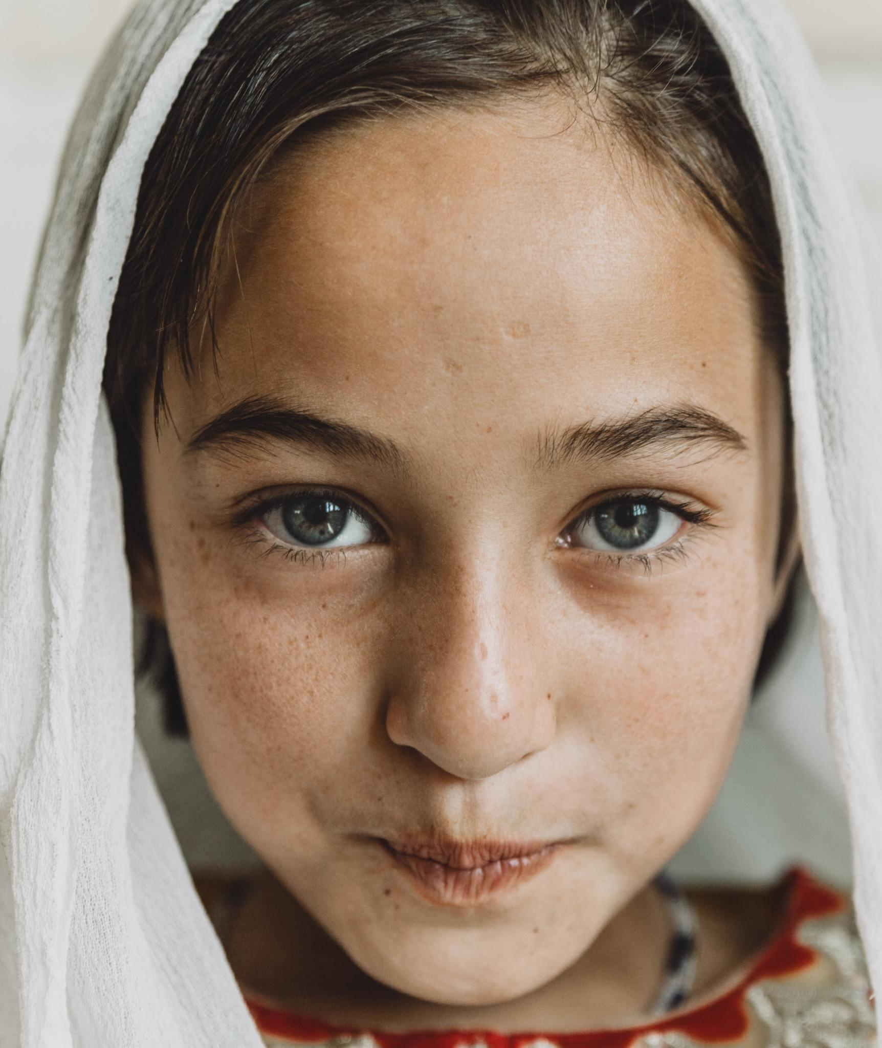
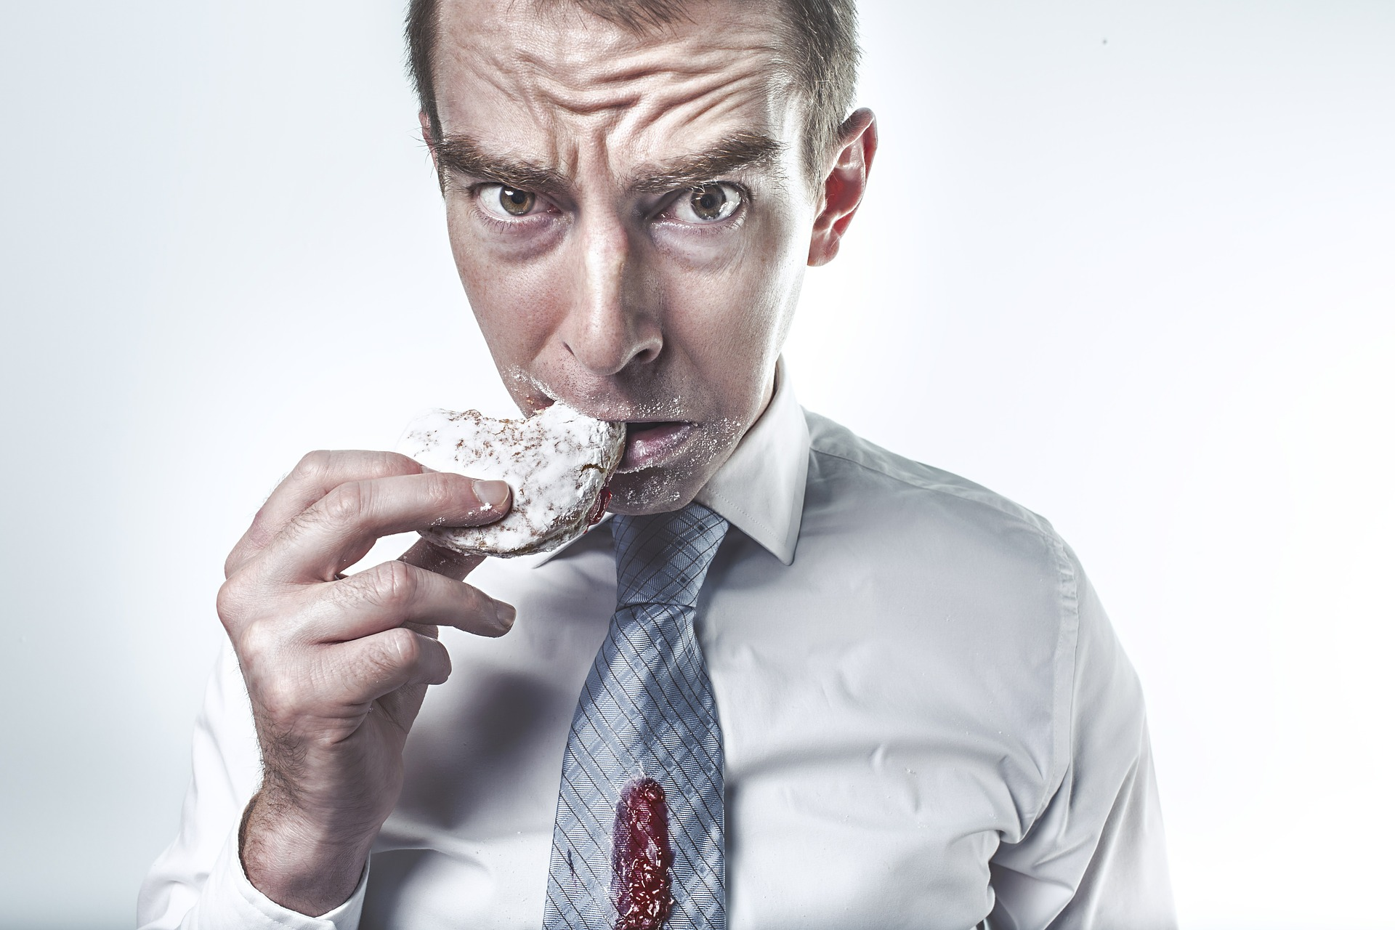
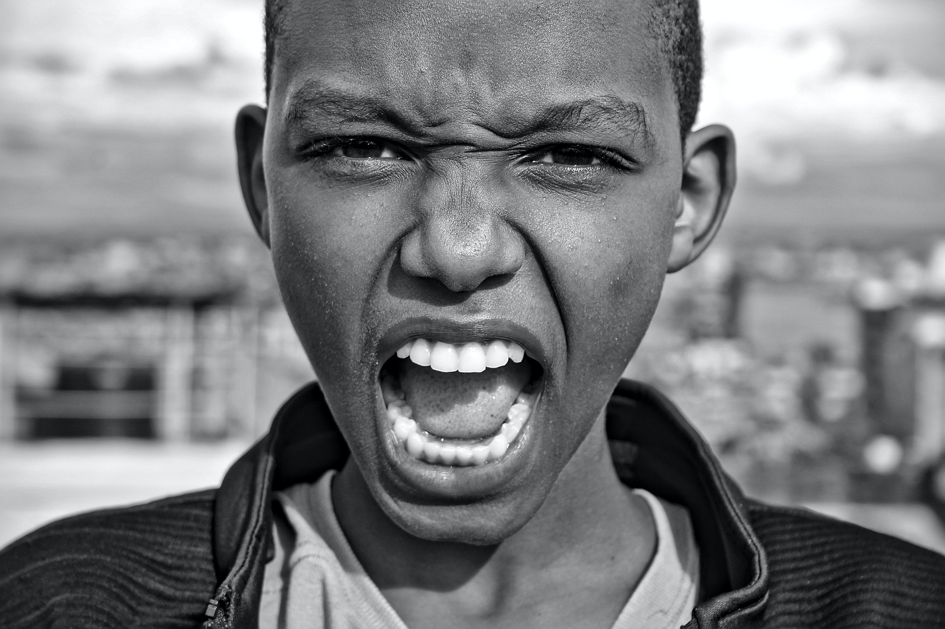
Tag Extraction --
Face Type Detection & Emotion detection Model
This model aims to tackle the task of predicting the age and classifying the gender, race and emotion from facial images.
Pretrained model: DEmo Classi
Backbone: Resnet50
Pretrained dataset:
Fer2013 dataset https://www.kaggle.com/msambare/fer2013
UTK face dataset
https://susanqq.github.io/UTKFace/
Model evaluation on pre-trained dataset:
Results | Precision | Recall | F1-score | Support
Emotion | 0.63 | 0.63 | 0.63 | 3589
Gender | 0.95 | 0.95 | 0.95 | 3556
Race | 0.87 | 0.87 | 0.86 | 3556

Slide 56
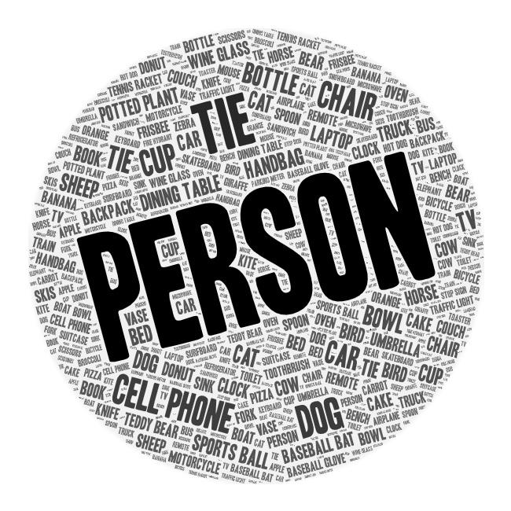
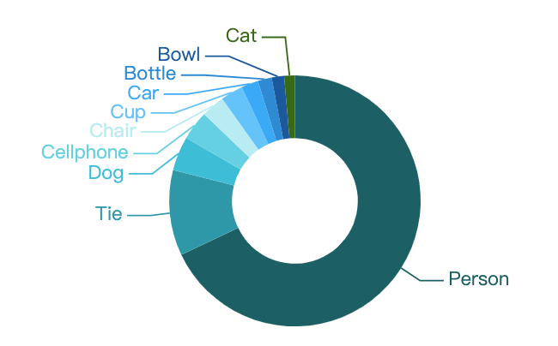
Results : Object Detection Results

Slide 57
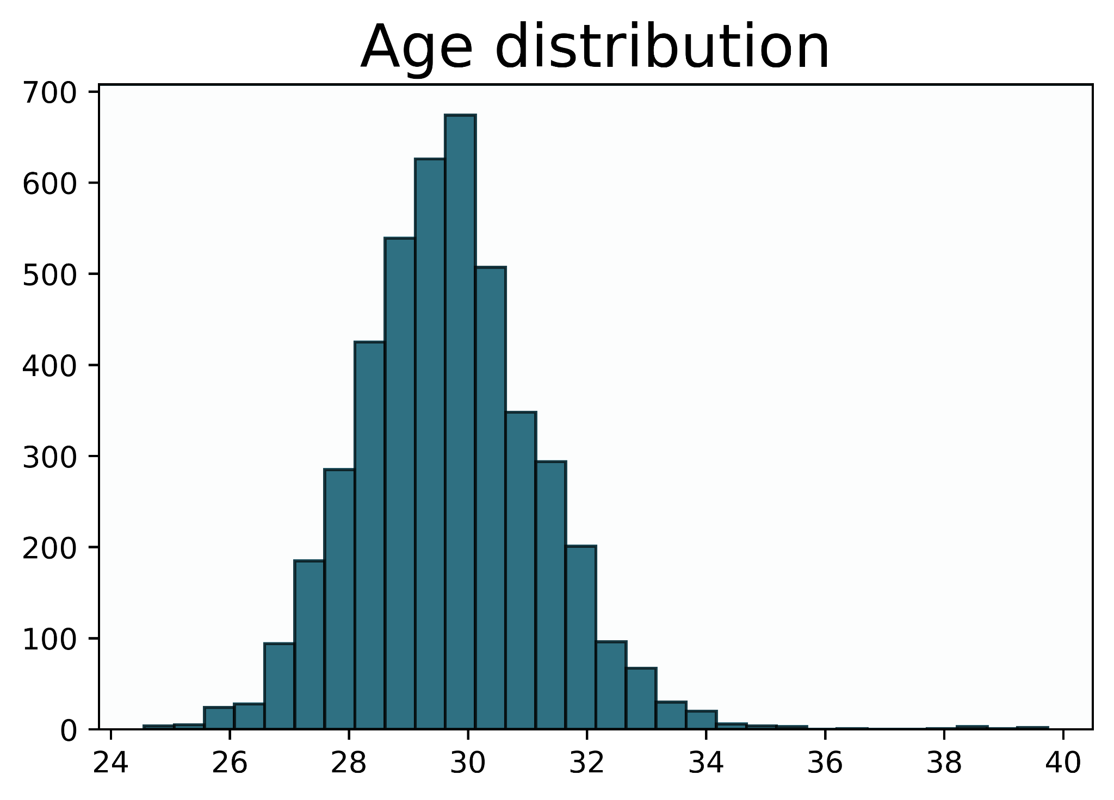
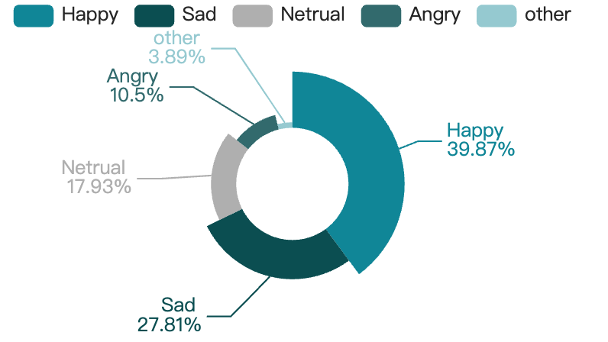
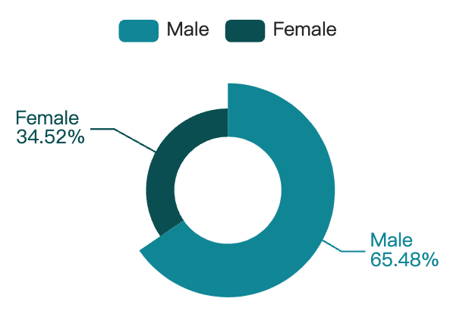
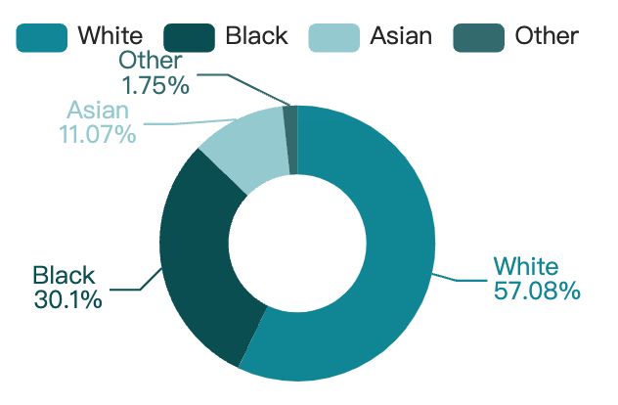
Results of Face Type Detection & Emotion detection Model
Emotion distribution
Gender distribution
Race distribution

Slide 58
Results : Performance Measures
Accuracy:
Accuracy represents the proportion of correctly predicted instances among the total instances. A higher accuracy indicates a better overall performance.
Precision:
Precision is the proportion of correctly predicted positive cases among all predicted positive cases. It is a measure of the model's ability to avoid false positives.
Recall (Sensitivity or True Positive Rate):
Recall is the proportion of correctly predicted positive cases among all actual positive cases. It measures the model's ability to capture all positive instances.
F1 Score:
F1 Score is the harmonic mean of precision and recall. It provides a balance between precision and recall, useful when there is an uneven class distribution.
Support:
Support represents the count of actual occurrences of each class in the dataset, offering insights into the distribution of classes. It is crucial for evaluating models in the context of imbalanced datasets.
Area Under the Receiver Operating Characteristic (ROC) Curve (AUC-ROC):
AUC-ROC represents the area under the ROC curve. It assesses the model's ability to distinguish between classes, with higher values indicating better discrimination.
Confusion Matrix:
A confusion matrix provides a detailed breakdown of the model's predictions, showing true positives, true negatives, false positives, and false negatives. It is useful for a deeper understanding of classification performance.

Slide 59
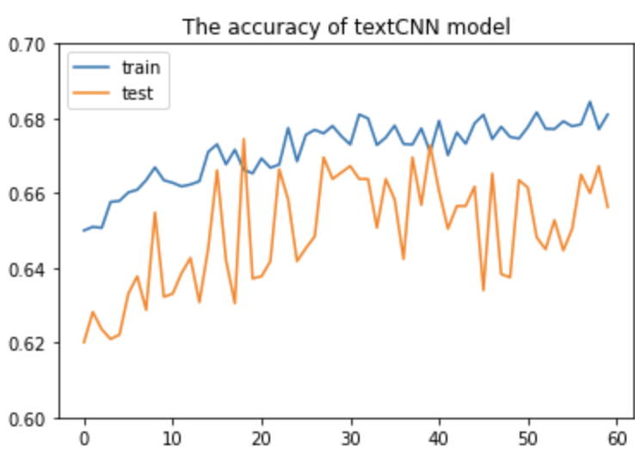
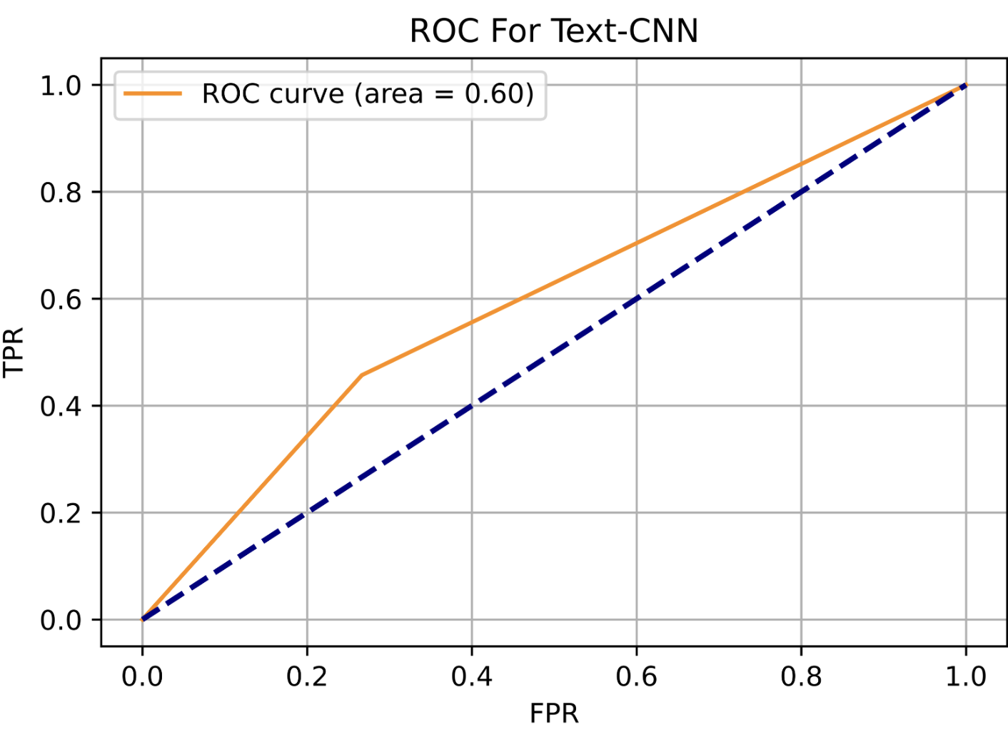
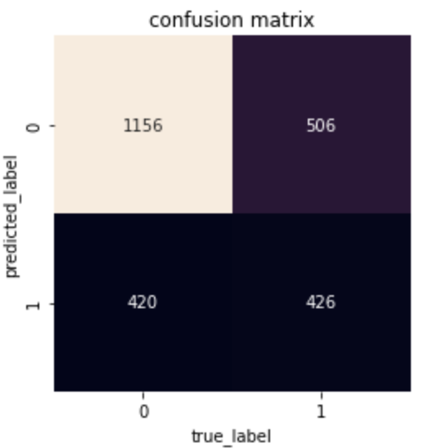
Results : TextCNN
The Text-CNN model exhibits moderate performance with an ROC score of 0.6 and an accuracy of approximately 66%. The confusion matrix reveals that the model is better at predicting negative instances than positive ones, with 1156 true negatives, 506 false positives, 420 false negatives, and 426 true positives. This suggests a need for a balance between precision and recall. Further analysis should focus on understanding the characteristics of false positives and false negatives to guide model improvements. Depending on project goals, adjustments to the model or evaluation metrics may be considered for enhanced performance.

Slide 60
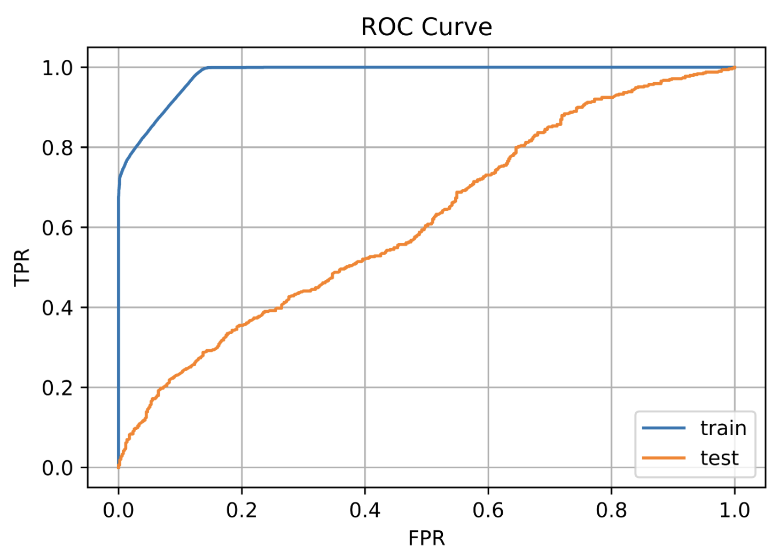

Results : BERT
The overall accuracy of the model is 0.58. This means that the model correctly classified 58% of the instances.
The macro average precision, recall, and f1-score are all 0.58. This means that the model's performance is similar for both classes.
The weighted average precision, recall, and f1-score are all 0.68. This means that the model's performance is weighted more heavily towards class 0, since there are more instances of class 0.
By seeing the ROC curve for BERT, it is indicated that it is not very efffective in detecting the hateful meme.

Slide 61


Results : TF_IDF
The ROC curve areas for different models, including Logistic Regression (LR), Support Vector Machine (SVM), Random Forest (RM), Naive Bayes (NB), and K-Nearest Neighbors (KNN), are relatively close, ranging from 0.58 to 0.59. In the context of hateful meme detection, these scores suggest that these models have a moderate ability to discriminate between positive and negative instances.
Even manual classification of these memes could only achieve an accuracy of 84%. Considering that manual classification achieved an accuracy of 84%, the models' performance, as indicated by ROC curve areas, falls below this benchmark.

Slide 62






Results : TF_IDF & RESNET
Logistic Regression
Random Forest
RESNET
KNN
These figures show the confusion matrix for algorithms used in TF_IDF. It can be seen that LR, SVM are better performing models when compared to other models as they could detect the hateful meme much efficiently then others.
SVM
Naive Bayes

Slide 63

Result Comparison : Performance Evaluation
Parameters:
Learning Rate = 0.0001 Weight decay = 0.05 Batch Size = 24 Dropout Rate =0.3 Gradient Accumulation Step = 2 Epoch = 50

Slide 64


Result Comparison

Slide 65
08
Project Management

Slide 66
Project Management : Implementation Status Report
Work Completed :
1)Exploratory Data Analysis
Description : In our hateful meme detection project, our team conducted an exploratory data analysis (EDA) on the dataset to gain valuable insights into its characteristics. Through this process, we explored various graphs and visualizations to better understand the distribution of data, identify patterns, and uncover potential relationships between different features.
Responsibility : To successfully do EDA, Pavan Ganta
Contributions : Pavan Ganta : 100%
Issues/Concerns : No issues/Concerns
2)Text CNN
Description : The TextCNN model in our hateful meme detection project employs Convolutional Neural Networks to extract local patterns from textual data, enhancing its ability to classify memes effectively.
Responsibility : To successfully do Text CNN, Rajasekhar Ponnuru ,Pavan Ganta & Srichandan Kota
Contributions : Rajasekhar Ponnuru : 33.3%, Pavan Ganta : 33.4%, Srichandan Kota : 33.3%
Issues/Concerns : No issues/Concerns
3)Face Recognition
Description : face recognition system utilizes deep learning techniques, specifically a pretrained ResNet model, to accurately identify and verify faces. The ResNet architecture enables effective feature extraction, allowing the model to discern intricate facial details.
Responsibility : To successfully do Face Recognition,Rajasekhar Ponnuru & Srichandan Kota
Contributions : Rajasekhar Ponnuru : 75%, Srichandan Kota : 25%
Issues/Concerns : No issues/Concerns
4)Object Detection
Description : Object detection in our project employs the YOLO (You Only Look Once) algorithm, a state-of-the-art deep learning approach. YOLO enables real-time detection of multiple objects within images, exhibiting high accuracy and efficiency.
Responsibility : To successfully do Object Detection, Rajasekhar Ponnuru & Srichandan Kota
Contributions : Rajasekhar Ponnuru : 75%, Srichandan Kota : 25%
Issues/Concerns : No issues/Concerns
5)Emotion Race & Age Detection
Description :
The project includes emotion, age, and gender detection using pre-trained deep learning models. For emotion detection, we utilize a Convolutional Neural Network (CNN) architecture trained on diverse facial expression datasets. Age and gender are determined through a separate model, likely a combination of CNNs and other techniques trained on datasets annotated with age and gender labels.
Responsibility : To successfully do Emotion, Race and Age Detection, Pavan Ganta & Srichandan Kota
Contributions : Pavan Ganta : 60%, Srichandan Kota : 40%
Issues/Concerns : No issues/Concerns

Slide 67
Project Management : Implementation Status Report
6)BERT
Description : n our project focused on detecting hateful memes, BERT (Bidirectional Encoder Representations from Transformers) plays a crucial role in understanding contextual information within textual content.
Responsibility : To successfully do BERT, Rajasekhar Ponnuru & Srichandan Kota
Contributions : Rajasekhar Ponnuru : 75%, Srichandan Kota : 25%
Issues/Concerns : No issues/Concerns
7)OCR
Description : In the context of our project, Optical Character Recognition (OCR) is utilized to extract text information from images and memes.
Responsibility : To successfully do OCR, Rajasekhar Ponnuru & Srichandan Kota
Contributions : Rajasekhar Ponnuru : 75%, Srichandan Kota : 25%
Issues/Concerns : No issues/Concerns
8)TF_IDF
Description : We have implemented multiple machine learning classifiers, including Logistic Regression (LR), Support Vector Machine (SVM), k-Nearest Neighbors (KNN), Random Forest (RF), and Naive Bayes (NB). Each of these classifiers serves as a distinct model for hateful meme detection, leveraging diverse algorithms and approaches to achieve optimal performance.
Responsibility : To successfully do TF_IDF, Pavan Ganta & Srichandan Kota
Contributions : Pavan Ganta : 70%, Srichandan Kota : 30%
Issues/Concerns : No issues/Concerns
9)RESNET
Description : In our project, we have incorporated ResNet, a deep convolutional neural network architecture renowned for its effectiveness in image classification tasks.
Responsibility : To successfully do Resnet, Pavan Ganta & Srichandan Kota
Contributions : Pavan Ganta : 70%, Srichandan Kota : 30%
Issues/Concerns : No issues/Concerns
10)VisualBERT
Description : In the context of our hateful meme detection project, VisualBERT has been employed as a powerful model combining both textual and visual information. VisualBERT integrates BERT (Bidirectional Encoder Representations from Transformers) with visual information, enabling the model to understand and process multimodal inputs.
Responsibility : To successfully do VisualBERT, Srichandan Kota
Contributions : Srichandan Kota : 100%
Issues/Concerns : No issues/Concerns

Slide 68
Conclusions
In this project, we proposed different kinds of classification models for hateful memes, including text-based unimodal, image-based unimodal and text-image-based multimodal models. However, all these models have performance that is not that satisfactory.
Therefore, we proposed a new model that first extract more labels including objects, human races, genders and emotions to expand our feature vector. The performance increases in terms of accuracy, recall, precision and auroc. This indicates that our attempts to add more tags to construct our new features actually make sense.
However, currently our labels are still not representative especially for objects. We could train more specific models that could detect more important objects instead of using pretrained models by others.
Although finding more representative tags could make effects, the project itself has its limitation. According to the initiator of the project, even manual classification of these memes could only achieve an accuracy of 84%. So unlike traditional image or text classification tasks, meme detection includes some more complicated logic reasoning that is hard for machine to detect.

Slide 69
Future Work
Better Tune our Models
Add Batch Normalization; Increase Dropout Rate;
Run more epoches
Extract Better Labels
Pretrain our own Face Classification Model;
Change Object Detection into Google Entity Detection [13]
Further Process our images
Remove texts from images;
Segment different images in a meme

Slide 70

Image Further Processing
Text Removal
Image Segmentation

Slide 71

Web Entity Detection (Provided by Google)
Object Result
Person, Cell phone
Entity Result
Carnival in Rio de Janeiro

Slide 72
References
[1] Firoj Alam, Ferda Ofli, and Muhammad Imran. Crisismmd: Multimodal twitter datasets from natural disasters. In Twelfth International AAAI Conference on Web and Social Media, 2018
[2] Zhu, R. (2020). Enhance multimodal transformer with external label and in-domain pretrain: Hateful meme challenge winning solution. arXiv preprint arXiv:2012.08290.
[3]Constantin, M. G., Pârvu, D. S., Stanciu, C., Ionascu, D., & Ionescu, B. (2021, July). Hateful meme detection with multimodal deep neural networks. In 2021 International Symposium on Signals, Circuits and Systems (ISSCS) (pp. 1-4). IEEE.
[4]Velioglu, R., & Rose, J. (2020). Detecting hate speech in memes using multimodal deep learning approaches: Prize-winning solution to hateful memes challenge. arXiv preprint arXiv:2012.12975.
[5]Wanbo, L., & Suying, L. (2021, May). Research on multi-modal hateful meme detection. In 2021 2nd International Conference on Artificial Intelligence and Information Systems (pp. 1-10).
[6] “TF–IDF.” Wikipedia, Wikimedia Foundation, 11 Feb. 2022, https://en.wikipedia.org/wiki/Tf%E2%80%93idf.
[7] Zhang, Ye, and Byron Wallace. "A sensitivity analysis of (and practitioners' guide to) convolutional neural networks for sentence classification." arXiv preprint arXiv:1510.03820 (2015).
[8] Devlin, Jacob, et al. "Bert: Pre-training of deep bidirectional transformers for language understanding." arXiv preprint arXiv:1810.04805 (2018).
[9] He, Kaiming, et al. “Deep Residual Learning for Image Recognition.” 2016 IEEE Conference on Computer Vision and Pattern Recognition (CVPR), 2016, https://doi.org/10.1109/cvpr.2016.90.
[10] Redmon, Joseph, et al. “You Only Look Once: Unified, Real-Time Object Detection.” 2016 IEEE Conference on Computer Vision and Pattern Recognition (CVPR), 2016, https://doi.org/10.1109/cvpr.2016.91.
[11] Viola, P., and M. Jones. “Rapid Object Detection Using a Boosted Cascade of Simple Features.” Proceedings of the 2001 IEEE Computer Society Conference on Computer Vision and Pattern Recognition. CVPR 2001, https://doi.org/10.1109/cvpr.2001.990517.
[12]Li, L. H., Yatskar, M., Yin, D., Hsieh, C. J., & Chang, K. W. (2019). Visualbert: A simple and performant baseline for vision and language. arXiv preprint arXiv:1908.03557.
[13]Ren, S., He, K., Girshick, R., & Sun, J. (2015). Faster r-cnn: Towards real-time object detection with region proposal networks. Advances in neural information processing systems, 28.

Slide 73
Thanks for your listening!
Presented by:
Srichandan Kota Rajasekhar Ponnuru Pavan Ganta

